Slide 1

Community Detection PolNet 2015 June 18, 2015
Scott Pauls
Department of Mathematics
Dartmouth College

Slide 2
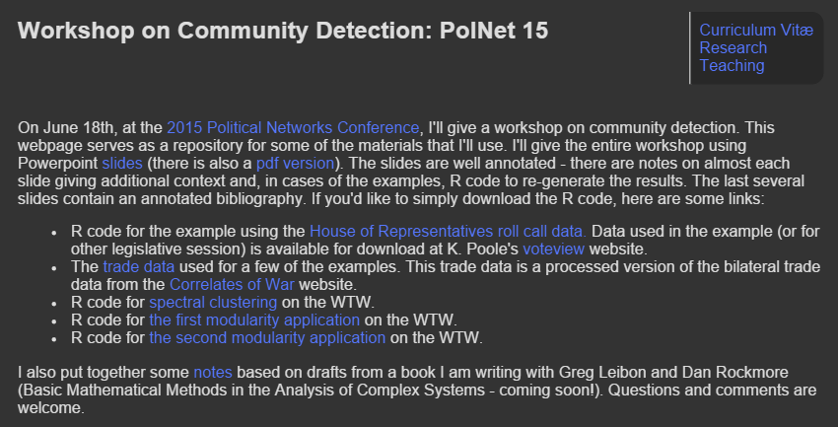
https://math.dartmouth.edu/~pauls/PolNet15/

Slide 3
Introductory throat clearing
Caveat: I’m a mathematician….
Slides (PPT/PDF): Most of the slides have some annotation in the “notes” section. These provide some context and elaboration.
Notes: The notes are taken from drafts of a forthcoming book (Basic Mathematical Methods in the Analysis of Complex Systems, with G. Leibon and D. Rockmore). You are the prime audience for such a book – any feedback is welcome!
R: All of the R code is available both as standalone scripts (via the website) as well as in the powerpoint in slides and in the notes. The code is written as simply as I could for clarity so in parts it can certainly be optimized.
Questions: You are welcome and encouraged to ask questions throughout. Due do some unforeseen circumstances, I won’t be around for the rest of the conference. So, if questions come up later, feel free to drop me a line at scott.pauls@dartmouth.edu

Slide 4
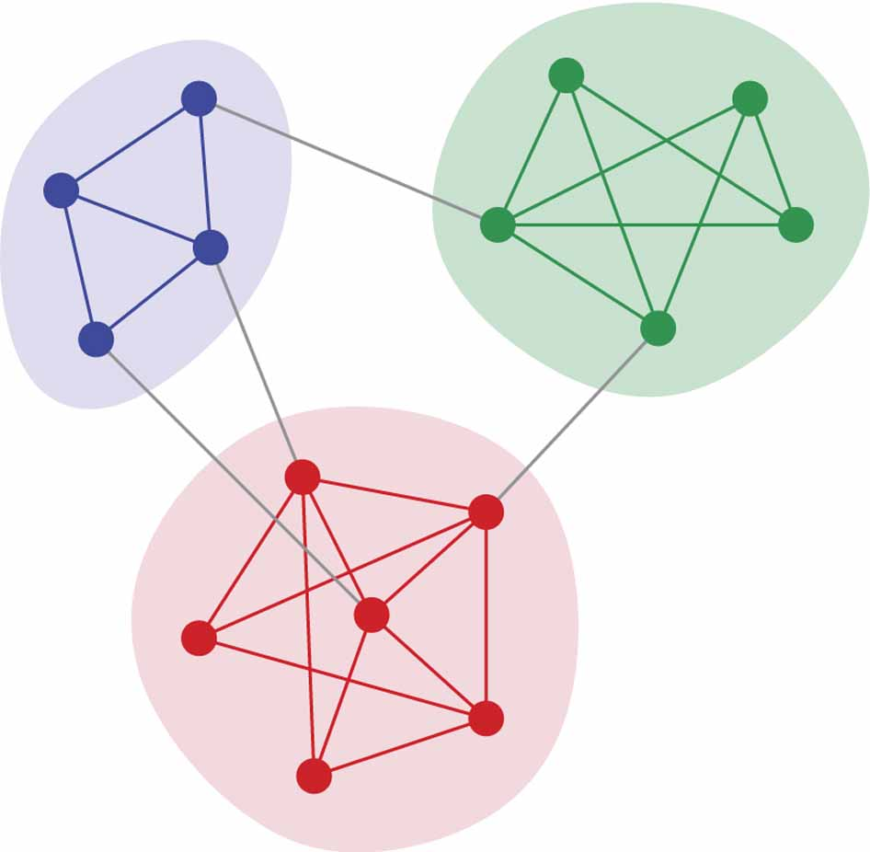
Begin at the beginning
To effectively break a network into communities, we must first ask ourselves two central questions:
Why do we wish to partition our network?
In our data set, what does it mean for two nodes to be in the same community? What does it mean for two nodes to be in different communities?
Image credit: M. E. J. Newman Nature Physics 8, 25-31 (2012) doi:10.1038/nphys2162
Notes:
You’ve all signed up to hear about community detection, so you must have an interest in figuring out how to find communities in networks. To discuss some of the myriad techniques for teasing out community structures, we must first decide why we are doing this at all. The reason is simple but compelling – without understanding our motivation for clustering data into communities, we won’t have a clear sense of what our found communities might mean. Clustering data without a clearly laid out goal in mind simply yields clusters and, while you might stumble upon interesting and relevant structure, without the additional context those clusters are often meaningless.

Slide 5
Why do we wish to partition our network?
Meso-scale Analysis
Dimension reduction/De-noising
Delineating structure
Data Exploration
Notes:
Here are four broad categories of reasons why we might cluster data. They are all interconnected and somewhat overlapping as finding communities can do all of them simultaneously. We’ll discuss each in turn.

Slide 6
Natural Scales
Historically, the analysis of social systems often takes places on three basic scales:
– the interactive dyad,
– the ego-network, and
– the entire system.
Notes:
In the social sciences, traditionally network analysis focuses on three scales – the dyad, the ego network, and the entire network. The dyad is the basic unit of interaction and many applications in the social sciences focus on dyadic interaction. Economics provides one of the clearest examples, where much of micro-economic modeling focuses on interaction between buyer and seller. The next scale – the ego network – while larger in scope than the dyad, is still fundamentally a local study of the network. Blowing up to the largest scale gives the whole network.
Each scale provides different avenues of investigation.
Dyad: How do qualities of the nodes impact the interaction?
Ego network: local network statistics (e.g. degree) as qualities of the node
Whole system: Global statistics, regressions, etc.

Slide 7
Meso-scale analysis
Identifying communities within a network provides a method for analysis at scales between local and global extremes.
Well defined communities allow us to coarsen our observation of the network to an intermediate scale, potentially revealing structure the is not apparent from examination of either ego-networks or the entire network.
Notes:
Communities within the network allow us to proceed with an analysis which is broader than the dyadic or ego-centric views, but falling short of the entire network. Such investigations hold the potential for great gains in understanding, but only if the communities themselves are meaningful and interpretable in the context of the social system represented by the network.
While much of this course is devoted to the nuts-and-bolts of finding communities, this is one of the main issues to hold in mind – without contextualization, the clusters and communities that you find are not interpretable.

Slide 8
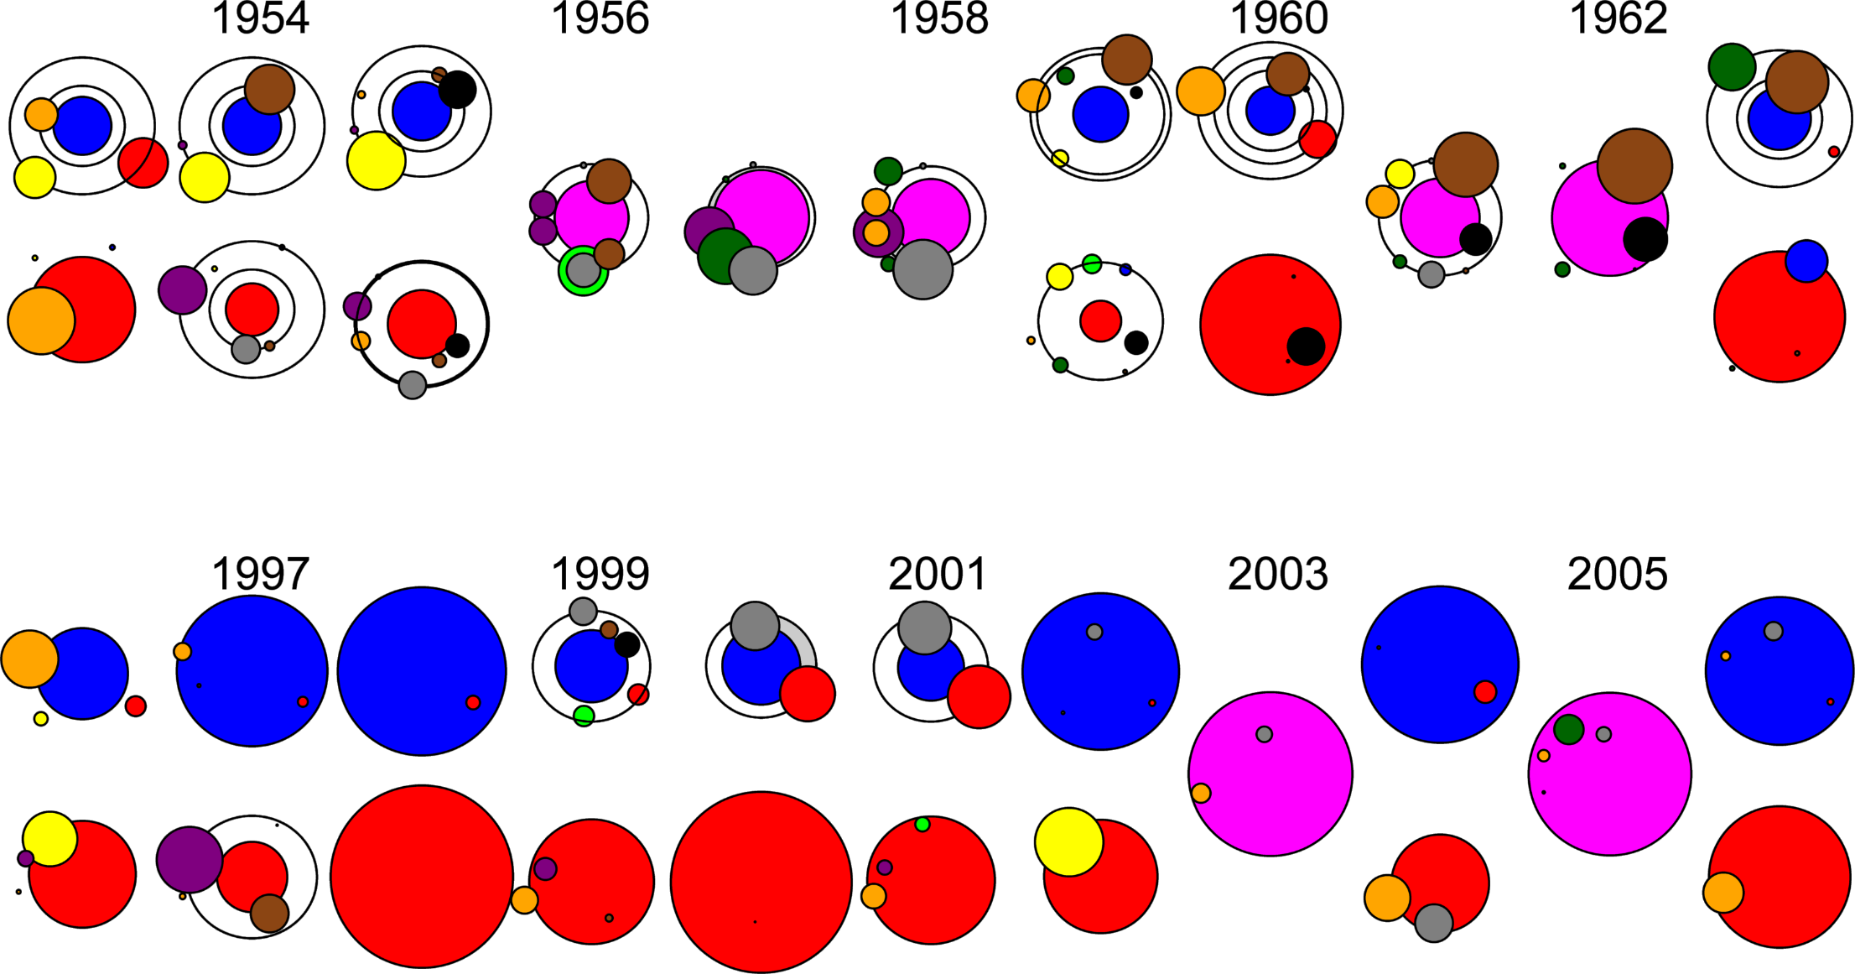
Communities in the United Nations
Notes:
In more recent work with Skyler Cranmer, we looked at communities in the UN as witnessed by their general assembly votes.
Why find communities? Here, we wanted to understand the extent to which behavior at the UN was predictive of various aspects of international relations (conflict, alliances, the spread of democracy). We hypothesized that the meso-scale structure revealed by the community structure would be reflective of these other processes.
As with SIV, we used spectral clustering on an adjacency matrix derived from the correlation matrix of voting profiles. We chose these for similar reasons.
The image is our representation of the community structure – the red and blue circles showing the dominant sub-cluster of each of the two basic meta-clusters in the data. Other circles in their “orbit” are the other sub-clusters in the meta-cluster. We selected these two time periods to show the heterogeneity over time.

Slide 9
Dimension reduction and de-noising
Finding communities allows us to aggregate nodes of the network into representative nodes.
Such an aggregation provides a dimension reduction – we reduce the number of nodes to the number of communities.
Moreover, data associated with the nodes may be aggregated over the community as well. Often, we associate the mean data vector to each representative node.
Notes:
Another motivation for finding communities is to make the data you have on your system easier to understand. Generally, data is messy, noisy, high dimensional, and generally hard to understand – if it weren’t we wouldn’t need additional techniques! Finding communities allows us to reduce the complexity of our data in two ways.
First, we achieve a dimension reduction by reducing the number of nodes in the system through constructing representative nodes for each community. These representatives have the properties that the nodes in the community all share – usually we construct them by finding the mean of the data over all the nodes in the community, or the majority position on categorical variables, etc. Such a dimension reduction gives us a new smaller network that can be easier to understand. Second, a consequence of this process is a de-noising of the data – the averaging of the data over communities smooth the data sources which can eliminate (some of the) noise.

Slide 10
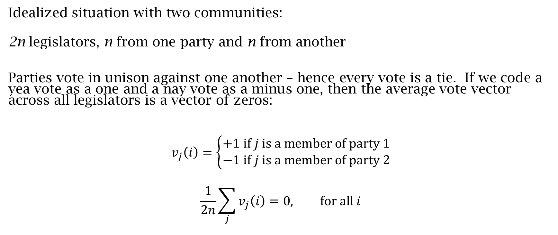
Example: legislative voting
Idealized situation with two communities:
2n legislators, n from one party and n from another
Parties vote in unison against one another – hence every vote is a tie. If we code a yea vote as a one and a nay vote as a minus one, then the average vote vector across all legislators is a vector of zeros:
$$v_{j}\left(i\right)=\left\{\begin{aligned}+1 \text{if} j \text{is} \text{a} \text{member} \text{of} \text{party}\text{ 1} \\ −1 \text{if} j \text{is} \text{a} \text{member} \text{of} \text{party}\text{ 2}\end{aligned}\right.$$
$$\frac{1}{2n}\sum_{j}{v_{j}\left(i\right)}=0, \text{for} \text{all} i$$
Notes:
Our first example that helps demonstrate this idea is an idealized version of legislative voting. We mock up some data that should give us exactly two communities by positing the existence of two parties who vote in lock-step against one another. We observe that the average over the entire legislature for each vote is zero – the parties are oppositional and equal in size. Consequently, looking at this global statistic doesn’t tell us much more than that. We can even think of slightly less idealized versions where individual sometimes vote against their party, where the global mean statistic carries a similar amount of information.

Slide 11
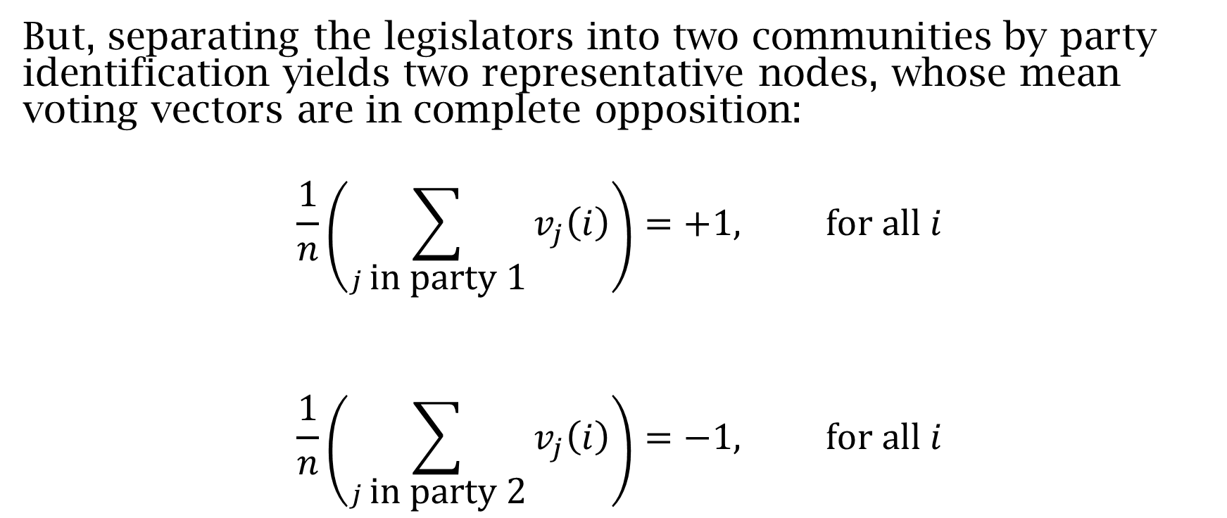
Example: legislative voting
But, separating the legislators into two communities by party identification yields two representative nodes, whose mean voting vectors are in complete opposition:
$$\frac{1}{n}\left(\sum_{j \text{in} \text{party}\text{ 1}}{v_{j}\left(i\right)}\right)=+1, \text{for} \text{all} i$$
$$\frac{1}{n}\left(\sum_{j \text{in} \text{party}\text{ 2}}{v_{j}\left(i\right)}\right)=−1, \text{for} \text{all} i$$
Notes:
But, if we break the legislature into two communities, we reap substantial benefits. There are now two representative nodes, one from each party, which have voting vectors than match the parties as a whole and are in opposition to one another. In this case, these two nodes and their associated vote vectors give a complete picture of the system – this is the best case scenario for both a meso-scale analysis and the accompanied dimension reduction.
In practice, of course, things are never this clean. But, this is a useful ideal to hold in mind when performing clustering – the closer our found communities reflect this behavior, the cleaner our analysis will be.

Slide 12
Delineating structure
Finding communities in both meso-scale analysis and dimension reduction schemes provide new windows through which to view our network.
Such a view can provide a clearer picture of the structure of the network at that scale.
Moreover, communities can have different attributes and structures from one another. This can be particularly important when trying to link communities to functional components of the system.
Notes:
A facet of moving the system to an intermediate scale through community detection is the potential for delineating different structural formations in the network. Different communities can exhibit different structures as subnetworks of the larger network that can point towards functional differences in the system.
In these cases, taxonomies of network types can be helpful in classifying the subnetworks, particularly when theory informs the network structure. A good example of this from organization sociology is Burt’s theory of structural holes – the delineation of communities and an examination of their internal structure allows us to more easily identify those nodes that bridge the structural holes in the network.

Slide 13
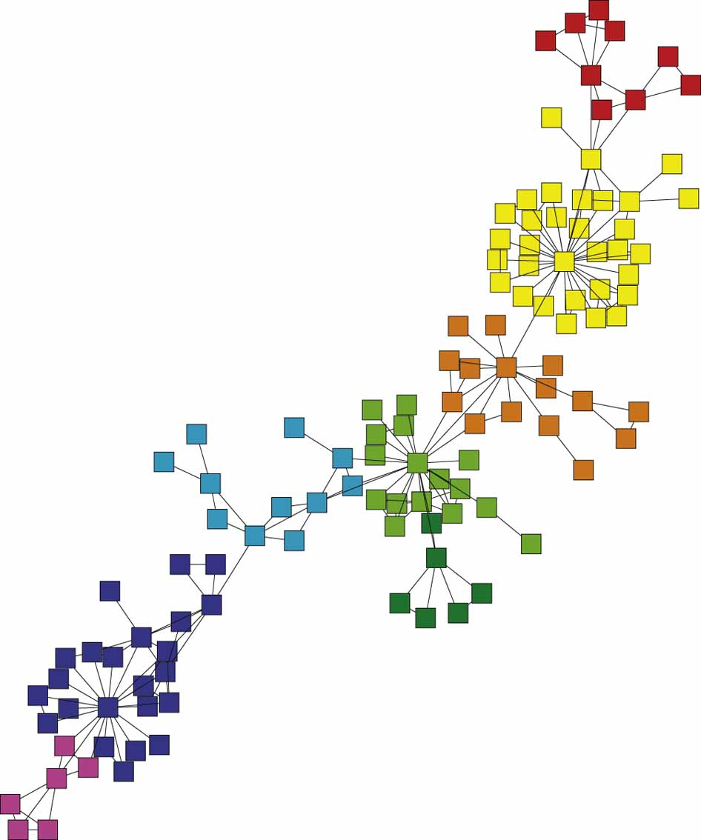
Notes:
From [1], a collaboration network. Note that some communities have a clear hub-spoke structure (e.g. the yellow, orange, and blue clusters) while others have a more diffuse network structure (e.g. light blue).
The former could indicate a formal collaboration style (e.g. a lab head and their team) while the latter could indicate a looser collection of affiliations.

Slide 14
Exploratory data analysis
Sometimes, you really have no idea what might be in a data set. Community detection can be used as an exploratory tool as well, to help you get a sense of the scope of things that might be true.
This is sometimes frowned upon – the dreaded data mining – but it certainly has a place when investigating data on a system on which you have little or no theory to base an investigation.

Slide 15
What does it mean for two nodes to be in the same community?
As we’ve seen, finding communities can bring new information to an analysis. But how do we define a community?
Generally, the answer to this question arises from a notion of similarity (or dissimilarity) between our nodes. We can define similarity in many ways, but most often we deem two nodes similar if the data we care about associated to the nodes is similar.
Notes:
With some motivation for finding communities in networks, we turn next to the second fundamental question – when are two nodes members of the same community. This question is often overlooked or, at least, underappreciated in a lot of the work that uses networks and community detect. The measure we choose to define similarity gives the basic underlying structure to our network. So make the choice a good one – make sure you are emphasizing the aspects of the data that are most important to your hypotheses.
While sometimes the choice of measure of less consequence, often it can dramatically change the landscape of your analysis.

Slide 16
What data do we use?
Examples:
Legislators:
roll call data, committee membership, co-sponsorship, fundraising data, interest group ratings, press release topics, etc.
International Relations:
government type, GDP, trade, alliances, conflict, etc.
Notes:
In each of these cases, just as the choice of similarity measure impacts your network structure, the choice of data informs what our analysis can reveal.

Slide 17
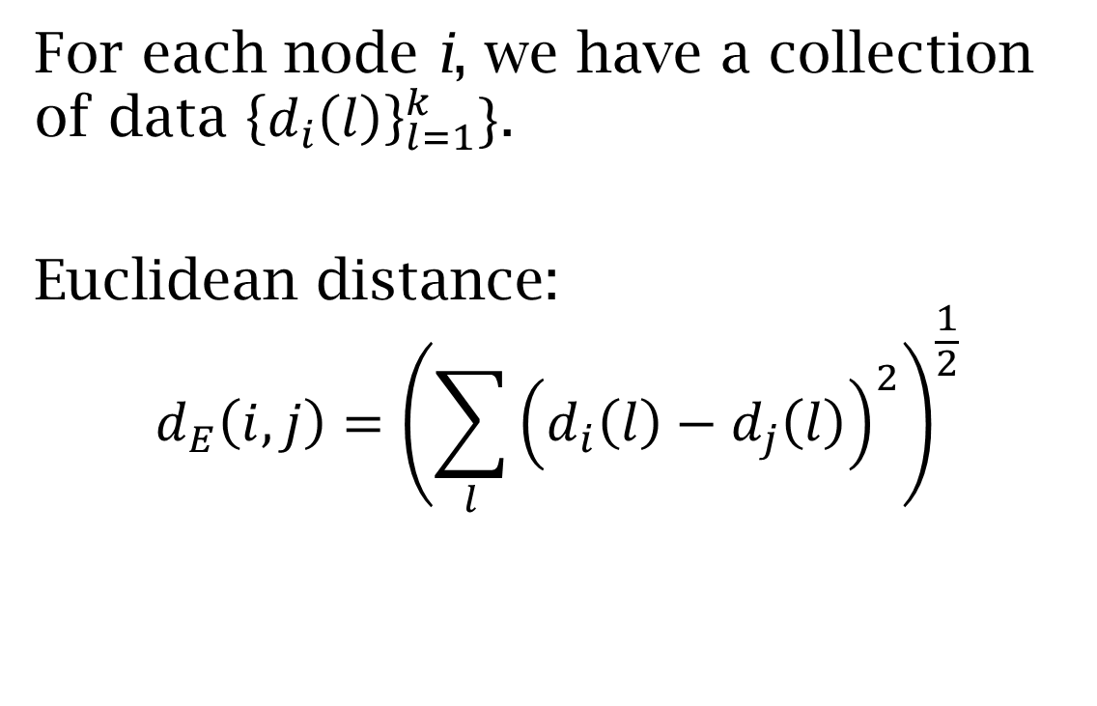
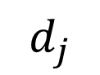
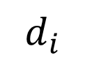
Measures of (dis)similarity
$$d_{i}$$
For each node i, we have a collection of data ${\left\{d_{i}\left(l\right)\right\}}_{l=1}^{k}\}$.
Euclidean distance:
$$d_{E}\left(i,j\right)={\left(\sum_{l}{{\left(d_{i}\left(l\right)−d_{j}\left(l\right)\right)}^{2}}\right)}^{\frac{1}{2}}$$
$$d_{j}$$
Notes:
Euclidean distance is a good choice when the data you have is a vector of real numbers, preferably measurements. Euclidean distance pays attention to both the direction and magnitude of the data vectors. Using Euclidean distance on categorical data can produce odd or misleading results unless the categories are represented in ways that are interpretable via the distance.
For example, if you have a variable coded as 1 = Bad, 2 = Good, 9 = Neutral, Euclidean distance can give you strange results. But a recoding with -1 = Bad, 0 = Neutral, and 1 = Good will likely give reasonable results.

Slide 18
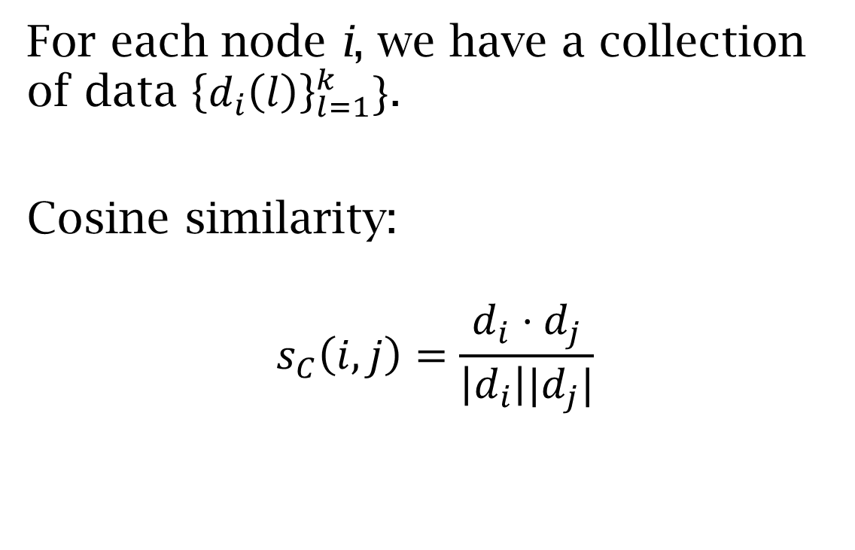
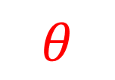
Measures of (dis)similarity
$$d_{i}$$
For each node i, we have a collection of data ${\left\{d_{i}\left(l\right)\right\}}_{l=1}^{k}\}$.
Cosine similarity:
$$s_{C}\left(i,j\right)=\frac{d_{i}⋅d_{j}}{\left|d_{i}\right||d_{j}|}$$
$$θ$$
$$d_{j}$$
$$d_{i}⋅d_{j}=|d_{i}||d_{j}|cos⁡(θ)$$
Notes:
Cosine similarity is useful when you wish to emphasize the angle between the vectors without paying attention to the magnitude - v and 100v have angle zero between them.

Slide 19
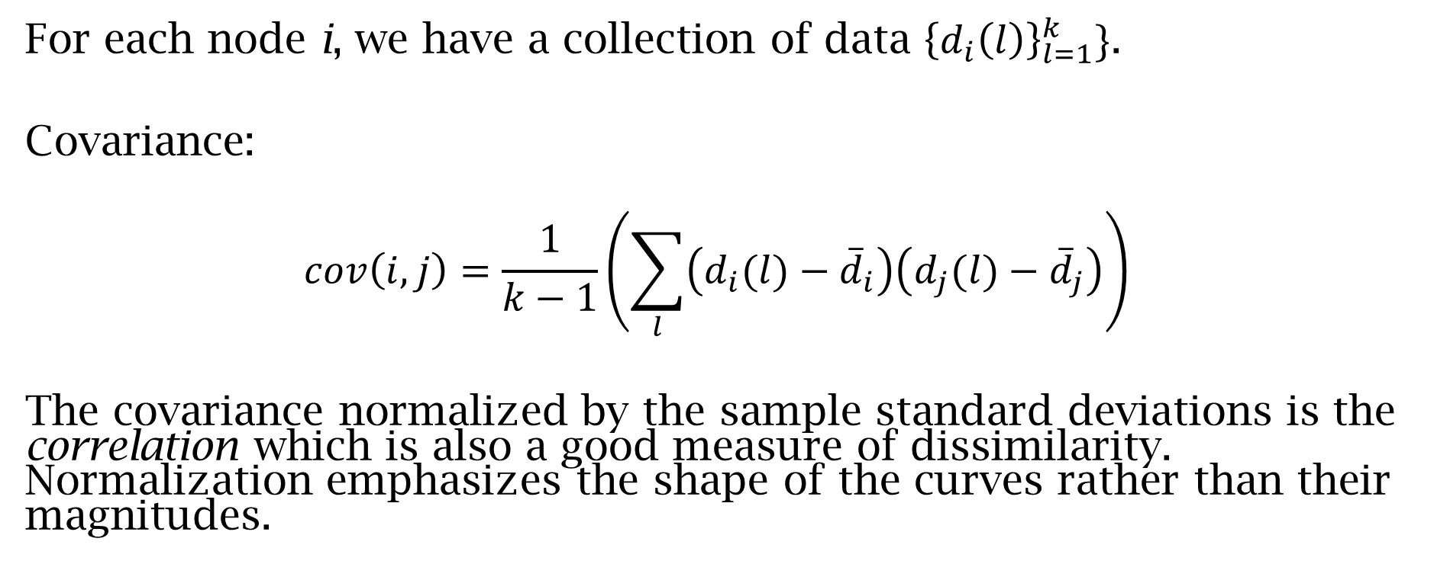
Measures of (dis)similarity
For each node i, we have a collection of data ${\left\{d_{i}\left(l\right)\right\}}_{l=1}^{k}\}$.
Covariance:
$$cov\left(i,j\right)=\frac{1}{k−1}\left(\sum_{l}{\left(d_{i}(l)−{\overline{d}}_{i}\right)\left(d_{j}(l)−{\overline{d}}_{j}\right)}\right)$$
The covariance normalized by the sample standard deviations is the correlation which is also a good measure of dissimilarity. Normalization emphasizes the shape of the curves rather than their magnitudes.
Notes:
Measures of covariance (or its normalization correlation) are statistically motivated. Covariance measures how well the two vectors, thought of as signals, move together. Two vectors have high covariance if, when thought of as curves, they have the same shape. Correlation, being the normalized version of covariance, pays attention to the shape, irrespective of magnitude.

Slide 20
What do I need to understand before applying a community detection technique
Why do I want to find communities? What questions will community detection help me answer?
What qualities define communities that are relevant to the questions I want to answer?
What information or data do I want to use to build quantitative measures for the qualities that define communities?
What measures do I build from that data?
What do you consider a successful outcome of a community detection algorithm?
Notes:
Without a solid answer to #1, you should not continue.
The answers to #2-4 should flow from #1 – while choices are sometimes constrained by external factors (e.g. availability and forms of data), whenever possible the choices at this stage should hew closely to the goals set forth in #1.
On #5: We pose this question with applications to social science in mind. In the network research community, where researchers focus on generating general techniques and algorithms that are widely applicable, the current answer is to test detection algorithms against empirical networks with known structure and/or synthetic networks with known, built communities. As Newman notes [1], “[W]e typically take one of two approaches. In the first, algorithms are tested against real-world networks for which there is an accepted division into communities, often based on additional measurements that are independent of the network itself, such as interviews with participants in a social network or analysis of the text of web pages. If an algorithm can reliably find the accepted structure then it is considered successful. In the second approach, algorithms are tested against computer-generated networks that have some form of community structure artificially embedded within them. Although these approaches do set concrete targets for performance of community-detection methods, there is room for debate over whether those targets necessarily align with good performance in broader real-world situations. If we tune our algorithms to solve specific benchmark problems we run the risk of creating algorithms that solve those problems well but other (perhaps more realistic) problems poorly.”
While these considerations are important, for research on a specific question their relevance decreases – we may (and should!) adapt general methods to the specifics of our inquiry.

Slide 21
Algorithms and Techniques
In our second portion of this workshop, we’ll delve into specific algorithms for detecting communities in networks.
Our goal is not anything approaching an exhaustive treatment but is more of an invitation to learn more – we’ll discuss four popular and useful techniques – hierarchical clustering, k-means, spectral clustering, and modularity maximization. Each one of these is really a collection of techniques that point the way to many elaborations and extensions.

Slide 22
Hierarchical Clustering
Given a measure of (dis)similarity, one of the most natural methods for grouping nodes together is to sequentially join nodes with the highest similarity.
Sequential aggregation creates a hierarchical decomposition of the network.
Linkage is perhaps the most popular algorithm implementing this idea.
Notes:
Classically, linkage use Euclidean distance as a dissimilarity measure. Linkage is used in many different settings (e.g. genetics, mathematical biology, as well as in the social sciences).

Slide 23
Linkage: algorithm
Locate the nodes with the highest similarity (or smallest dissimilarity).
Aggregate the two nodes into a new node.
Create distances to the remaining nodes from the new node according to an algorithm:
Single linkage: take the minimum of the distances from the aggregated nodes to the other node
Average linkage: take the average of these distances
Complete linkage: take the maximum of these distances
Notes:
We’ll use the toy network to the right as a running example for our methods. While links are shown, for linkage we’ll use their positions in the plane and Euclidean distance between those locations as our measure of dissimilarity.

Slide 24
Notes:
Our shortest distance is between the two orange nodes which we combine in our first iteration of linkage. As part of the algorithm, for each node we record the distance at which the node is absorbed into an aggregate node.

Slide 25
Notes:
In our second step, there are two pairs with the same distance. We aggregate them simulataneously.

Slide 26
Notes:
Linkage continues until all nodes have been absorbed into a single (large) node.

Slide 27
0
Notes:
We can put this steps and information together into one object – a dendrogram. Dendrograms capture all the information in linkage at once and provide a nice picture of the results. By selecting a height, one can recover any intermediate grouping.

Slide 28
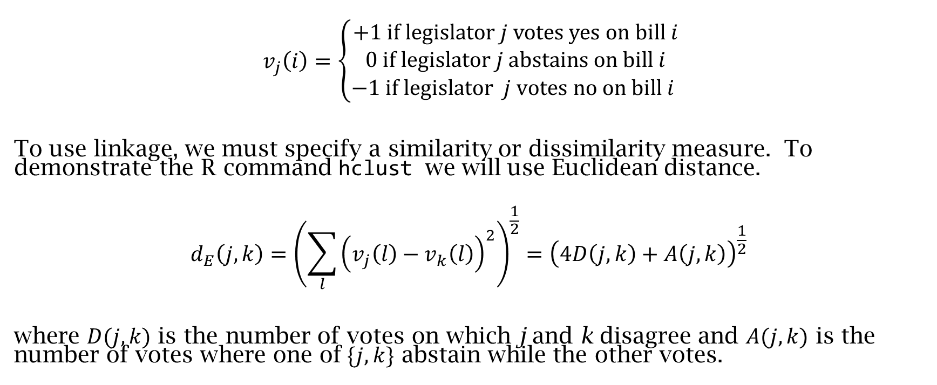
Example: Voting behavior of legislators
$$v_{j}\left(i\right)=\left\{\begin{aligned}\begin{matrix}+1 \text{if} \text{legislator} j \text{votes} \text{yes} \text{on} \text{bill} i \\ 0 \text{if} \text{legislator} j \text{abstains} \text{on} \text{bill} i\end{matrix} \\ −1 \text{if} \text{legislator} j \text{votes} \text{no} \text{on} \text{bill} i \end{aligned}\right.$$
To use linkage, we must specify a similarity or dissimilarity measure. To demonstrate the R command hclust we will use Euclidean distance.
$$d_{E}\left(j,k\right)={\left(\sum_{l}{{\left(v_{j}\left(l\right)−v_{k}\left(l\right)\right)}^{2}}\right)}^{\frac{1}{2}}={\left(4D\left(j,k\right)+A\left(j,k\right)\right)}^{\frac{1}{2}}$$
where $D(j,k)$ is the number of votes on which j and k disagree and $A(j,k)$ is the number of votes where one of$\{j,k\}$ abstain while the other votes.
Notes:
We return to thinking about legislative voting. Instead of the ideal case we thought about before, we’ll use real data (retrieved from K. Poole’s voteview.com). If we want to use linkage, the standard distance we use is Euclidean distance (side note: think about what this choice of metric will impose on the network) but the standard voteview method of encoding votes (1,2,3 = yes, 4,5,6 = n, 7,8,9= missing) will yield very funny distances if applied directly. So, we change the encoding of the vote to better match the metric.

Slide 29
Data preparation in R
We use the Political Science Computational Laboratory as it contains routines to read and process roll call data curated by Keith Poole (voteview.com). We’ll use the data from the 113th House of Representatives.
Roll call data has a standard coding: 1,2,3=yes, 4,5,6=no, 7,8,9 = missing, 0 = not in the legislature.
We amend the coding mapping {1,2,3} to 1, {4,5,6} to -1, and {0,7,8,9} to zero.
Notes:
#Load the Political Science Computational Laboratory library
library("pscl")
#Read in roll call data (using readKH from pscl)
h113<-readKH("hou113kh.ord",dtl=NULL,yea=c(1,2,3),nay=c(4,5,6),missing=c(7,8,9),notInLegis=0,desc="113th House of Representatives",debug=FALSE)
#Extract the matrix of votes
votes<-as.matrix(h113$votes)
#Edit the vote categories to {-1,0,1}
votes0=votes
votes0[votes0==9]=0
votes0[votes0==0]=0
votes0[votes0==6]=-1

Slide 30
R code
#Load the Political Science Computational Laboratory library
library("pscl")
#Read in roll call data (using readKH from pscl)
h113<-readKH("hou113kh.ord",dtl=NULL,yea=c(1,2,3),nay=c(4,5,6),missing=c(7,8,9),notInLegis=0,desc="113th House of Representatives",debug=FALSE)
#Extract the matrix of votes
votes<-as.matrix(h113$votes)
#Edit the vote categories to {-1,0,1}
votes0=votes
votes0[votes0==9]=0
votes0[votes0==0]=0
votes0[votes0==6]=-1

Slide 31
Linkage in R
For our demonstration, we compute the Euclidean distance between the voting profiles of the legislators.
We then use complete linkage on the resulting distances.
We plot the dendrogram to help us examine the results.
Notes:
#Compute the distances between the vote vectors
d<-dist(na.omit(votes0))
#Perform complete linkage
linkage<-hclust(d,method="complete",members = NULL)
#Plot the dendrogram derived from linkage
plot(linkage, labels = NULL, hang = 0.1, check = TRUE,axes = TRUE, frame.plot = FALSE, ann = TRUE,main = "Dendrogram for 113th House",sub = NULL, xlab = "Representative", ylab = "Height")

Slide 32
R code
#Compute the distances between the vote vectors
d<-dist(na.omit(votes0))
#Perform complete linkage
linkage<-hclust(d,method="complete",members = NULL)
#Plot the dendrogram derived from linkage
plot(linkage, labels = NULL, hang = 0.1, check = TRUE,axes = TRUE, frame.plot = FALSE, ann = TRUE,main = "Dendrogram for 113th House",sub = NULL, xlab = "Representative", ylab = "Height")

Slide 33
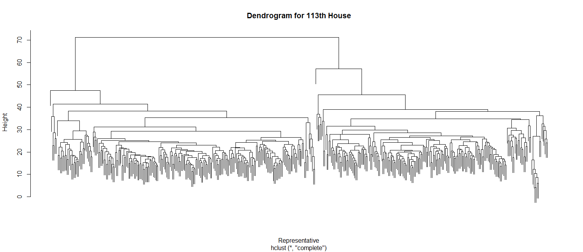
Complete Linkage: 113th House of Representatives
Notes:
I’ve added the shaded boxes to indicate an interpretation for the top level clusters – party caucus. Those representatives in the red box caucus with the Republicans while almost all of those in the blue box caucus with the Democrats.
Questions:
What does the differences in heights mean at the top level?
Can you determine which party caucus has more distinct subgroups?

Slide 34
113th House of Representatives
Linkage separates the House coarsely by party, but not perfectly. However, we can easily explain the misclassifications.
Speaker of the House Boehner (R OH-8), who votes very differently than his party for procedural reasons, is classified with the main Democratic cluster. Reps. Brat and Emerson are similarly classified, but for a different reason – they only voted on a small number of votes.
Notes:
Both Brat and Emerson only sat as representatives for a short time during this session. Rep. Emerson resigned shortly after the beginning of the session to take a job in the private sector while Rep. Brat was sworn in late in the session to fill the seat vacated by Rep. Cantor.

Slide 35
Linkage: observations and considerations
Linkage uses only (dis)similarity data – the Euclidean distance in our example – not network data.
Results are (usually) highly dependent on the (dis)similarity we choose.
One of the nice properties of linkage is that we get lots of different clusterings at once, by picking different thresholds in the dendrogram.
Linkage works well with communities whose members are tightly grouped and with relatively large distances between communities.
Notes:
Linkage has moderate computational cost – there are $n^{2}$ distance computations in the first iteration and $O(n)$ for each step after that.

Slide 36
Representative clustering
In thinking about why we might want to find communities in networks, we discussed the idea of using representatives from each community as a form of dimension reduction for our system.
One category of community detection techniques take this idea as primary motivation for an algorithm.
Notes:
Linkage took the notion of similarity as it’s central organizing motivation. Representative clustering techniques use similarity to help define the representative nodes for different communities.

Slide 37
The basic idea is to find the stars in the figure to the right – representative objects which summarize the cluster of nodes associated to them.
The k-means algorithm is probably the most popular algorithm of this type. The idea is simple:
We assume that we’ve defined nodes as points in a high dimensional space.
Start with a set of k representatives in the space of nodes (e.g. take a random set of k points in the high dimensional space).
Assign each node to the representative it is closest to by some metric.
Re-calculate the representatives by taking the mean position of the nodes in that cluster.
Repeat until the representatives’ positions converge.
Notes:
Observation: Linkage and k-means give different results for our toy network.

Slide 38
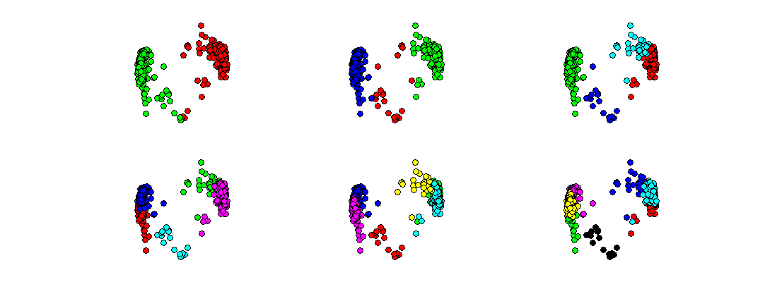
k-means: 113th House of Representatives
km<-kmeans(na.omit(votes0),k,iter.max=100,nstart=1000)
Notes:
R code to find k clusters:
km<-kmeans(na.omit(votes0),k,iter.max=100,nstart=1000)
Images of k-means results for $k∈\{2,…,7\}$. Coordinates for the nodes are given by the first two PCA coordinates for the data.
Observations:
For k=2, we get a split along party lines.
For k>3, we see instances of vectorization.
Questions:
Which cases do you think are defensible as “valid” communities?
How do we interpret vectorization of larger communities?

Slide 39
How many clusters?
There are many methods, none perfect, for determining the “correct” number of clusters.
Validation
Elbowology
Silhouettes
Information theoretic measures
Cluster consistency
Null models

Slide 40
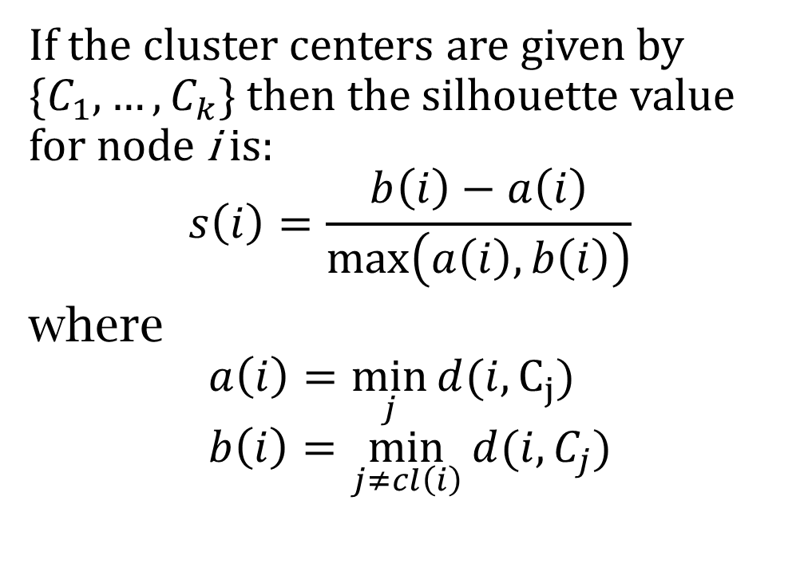
Silhouettes
Average s values over nodes in each cluster
1 | 0.57 | 0.14 | -0.03 | -0.03 | -0.04 | 0.25
2 | 0.52 | 0.38 | 0.29 | 0.29 | 0.03 | 0.13
3 |  | 0.39 | 0.23 | 0.26 | 0.26 | -0.04
4 |  |  | 0.32 | 0.09 | 0.08 | 0.03
5 |  |  |  | 0.08 | 0.09 | 0.03
6 |  |  |  |  | 0.08 | 0.08
7 |  |  |  |  |  | -0.03
If the cluster centers are given by $\{C_{1},…, C_{k}\}$ then the silhouette value for node i is:
$$s\left(i\right)=\frac{b\left(i\right)−a\left(i\right)}{\max\left(a\left(i\right),b\left(i\right)\right)}$$
where
$$a\left(i\right)=\min_{j}{d(i,}C_{j}) \\ b\left(i\right)=\min_{j≠cl\left(i\right)}{d(i,C_{j})}$$
sil<-silhouette(km$cluster,d)
Notes:
The silhouette measure indicates how close the nodes are to the centers of the communities. They are normalized so that they have a maximum of 1 and generally are positive – negative values of s indicate that some of the nodes may be misclassified.
In our case, the two community clustering stands out as the most consistent although 3 communities is arguably reasonable. For more than three communities, there is always at least one cluster which fares poorly by this measure and hence should be ignored. This corresponds to the onset of vectorization.
R code for k clusters:
km<-kmeans(na.omit(votes0),k,iter.max=100,nstart=1000)
sil<-silhouette(km$cluster,d)
summary(sil)

Slide 41
k-means: observations and considerations
Like linkage, the algorithm only uses a measure of dissimilarity between the nodes.
The number of communities, k, is a parameter the user must set from the outset.
The algorithm is trying to find a minimum – k representatives whose associated nodes are as close as possible to them. This is a very difficult problem globally and the algorithm only finds a local solution based on this initial candidates for representatives.
The communities in k-means are ball-like in that they tend to look like spheres in the high dimensional representation space. Indeed, if the points in k-means are selected at random from k spherical Gaussians distributions, k-means will recover the means of those distributions.
Notes:
Computational cost: $O(kn)$ as presented.

Slide 42
Cut problems on networks
In a sense, both linkage and k-means act on the raw data that we use to define a network, but don’t really use network properties.
For our next community detection algorithm, we approach the problem as a network-theoretic one. This simplest version of this question arises if we try to find two communities: what is the smallest number of edges we need to cut to disconnect the network?

Slide 43
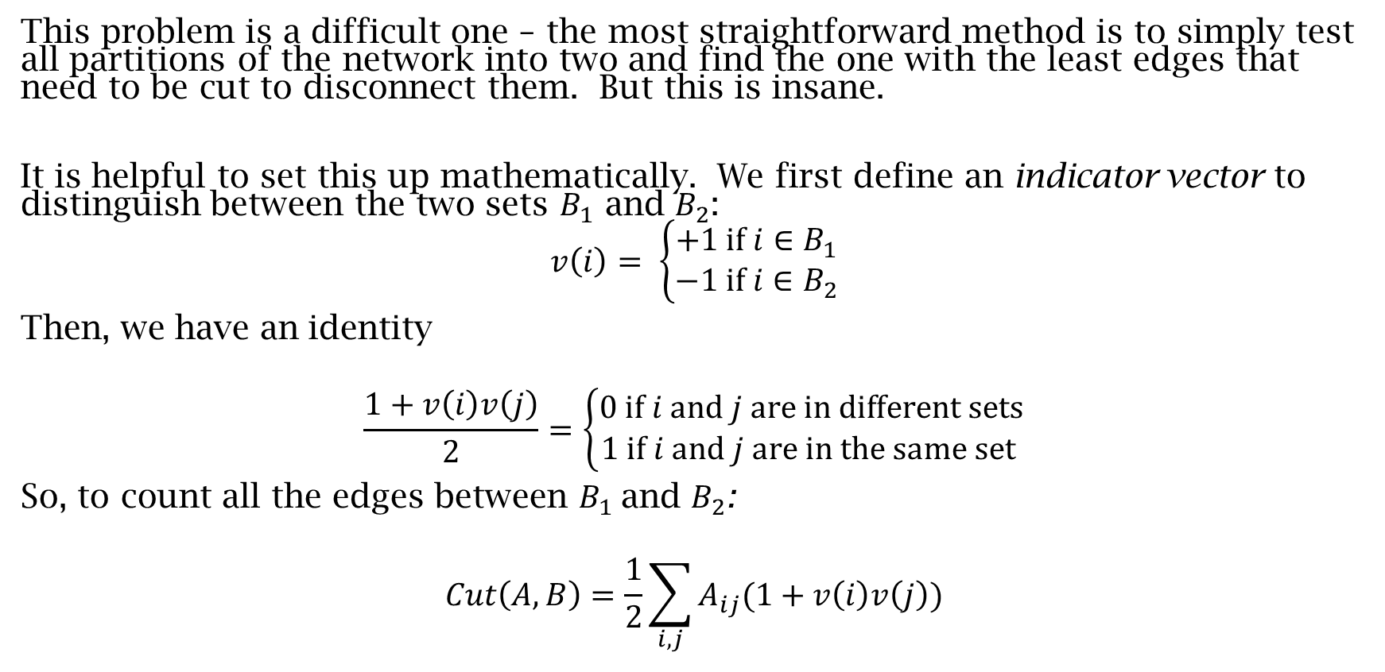
Spectral clustering
This problem is a difficult one – the most straightforward method is to simply test all partitions of the network into two and find the one with the least edges that need to be cut to disconnect them. But this is insane.
It is helpful to set this up mathematically. We first define an indicator vector to distinguish between the two sets $B_{1}$ and $B_{2}$:
$$v\left(i\right)= \left\{\begin{aligned}+1 \text{if} i∈B_{1} \\ −1 \text{if} i∈B_{2}\end{aligned}\right.$$
Then, we have an identity
$$\frac{1+v\left(i\right)v\left(j\right)}{2}=\left\{\begin{aligned}0 \text{if} i \text{and} j \text{are} \text{in} \text{different} \text{sets} \\ 1 \text{if} i \text{and} j \text{are} \text{in} \text{the} \text{same} \text{set} \end{aligned}\right.$$
So, to count all the edges between $B_{1}$and $B_{2}$:
$$Cut\left(A,B\right)=\frac{1}{2}\sum_{i,j}{A_{ij}(1+v\left(i\right)v\left(j\right))}$$
Notes:
While intuitive, this idea is extremely computationally expensive – an NP-hard problem. Our goal is to find a solvable problem which is close enough to this one and use those solutions as approximations to the real ones.
To do this, we formulate the problem mathematically with the goal of finding a linear algebraic version.

Slide 44
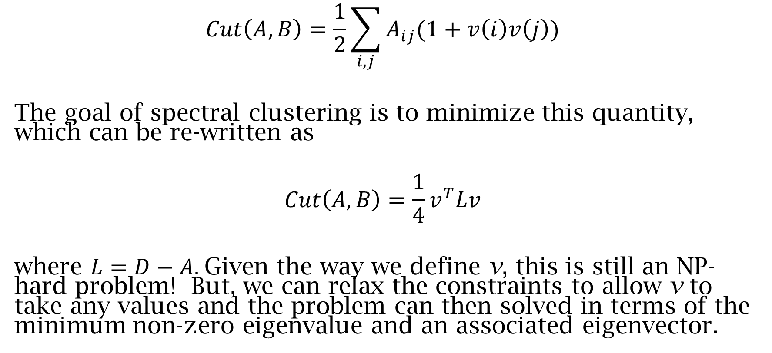
Minimum cut problem
$$Cut\left(A,B\right)=\frac{1}{2}\sum_{i,j}{A_{ij}(1+v\left(i\right)v\left(j\right))}$$
The goal of spectral clustering is to minimize this quantity, which can be re-written as
$$Cut\left(A,B\right)=\frac{1}{4}v^{T}Lv$$
where $L=D−A.$Given the way we define v, this is still an NP-hard problem! But, we can relax the constraints to allow v to take any values and the problem can then solved in terms of the minimum non-zero eigenvalue and an associated eigenvector.

Slide 45
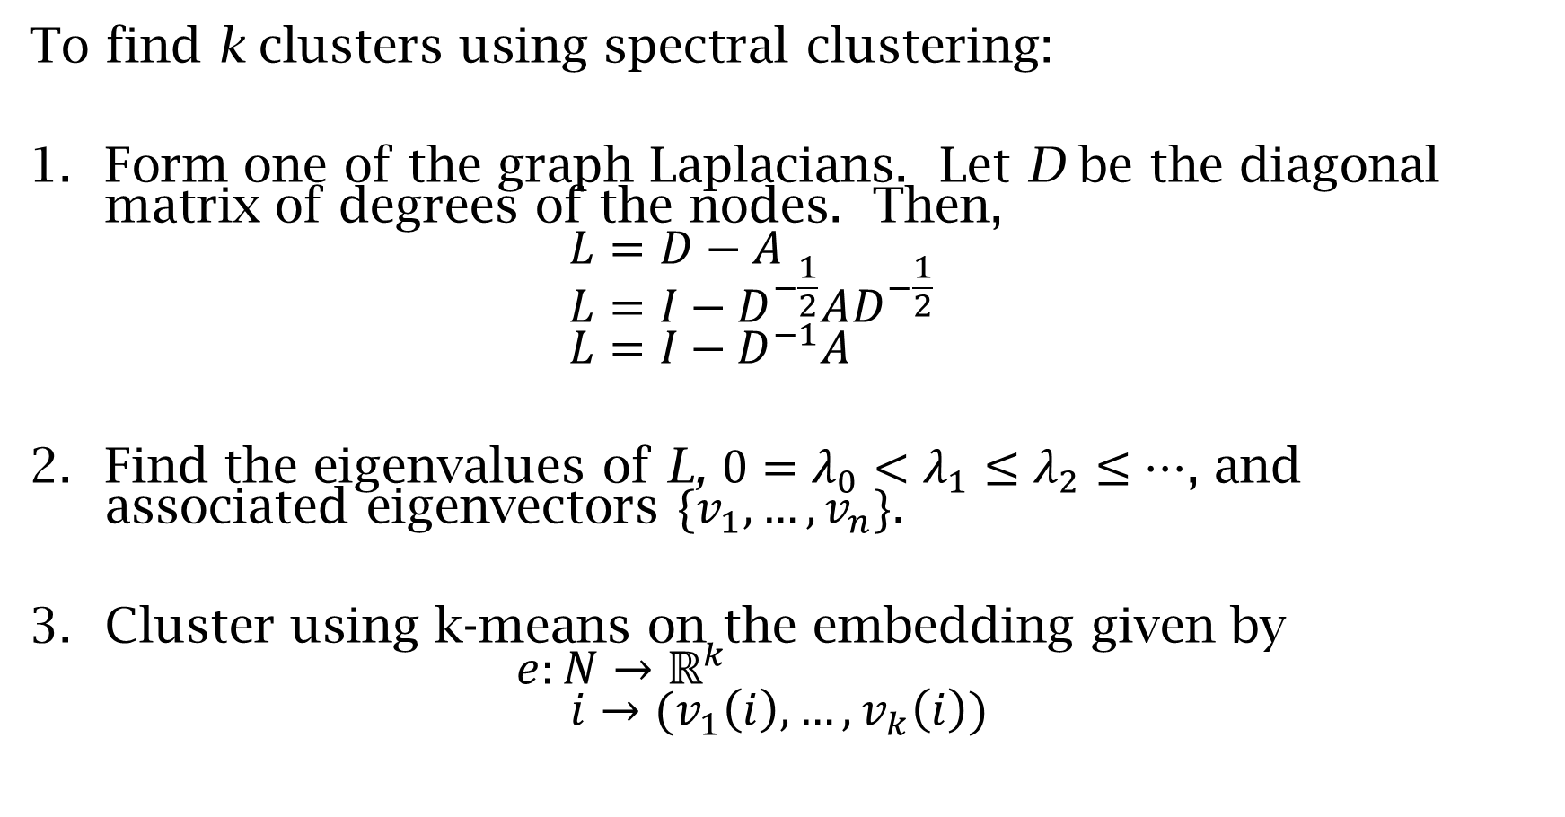
Algorithm
To find k clusters using spectral clustering:
Form one of the graph Laplacians. Let D be the diagonal matrix of degrees of the nodes. Then, $L=D−A$ $L=I−D^{−\frac{1}{2}}AD^{−\frac{1}{2}}$ $L=I−D^{−1}A$
Find the eigenvalues of L, ${0=λ}_{0}<λ_{1}≤λ_{2}≤…$, and associated eigenvectors $\{v_{1},…,v_{n}\}$.
Cluster using k-means on the embedding given by $e:N→ℝ^{k}$ $i→(v_{1}\left(i\right),…,v_{k}\left(i\right))$
Notes:
Our relaxed version of the problem leads us to an algorithm for finding communities. These communities have the property that they are the most easily separable subsets of the network.

Slide 46
Example: Trade Networks
Trade networks are often used in International Relations as they contain potential explanatory variables for state interactions of different types.
We choose trade networks as an example for several reasons. First, it is naturally network data – we have totals of imports and exports between each pair of countries – rather than data that can easily be used with k-means or linkage. Second, communities derived using spectral clustering have natural interpretations in the setting of a trade network. Third, communities in a trade network give us meso-scale information about the network that can be used, for example, as covariates in regressions.
Notes:
We use trade data from the Correlates of War project.

Slide 47
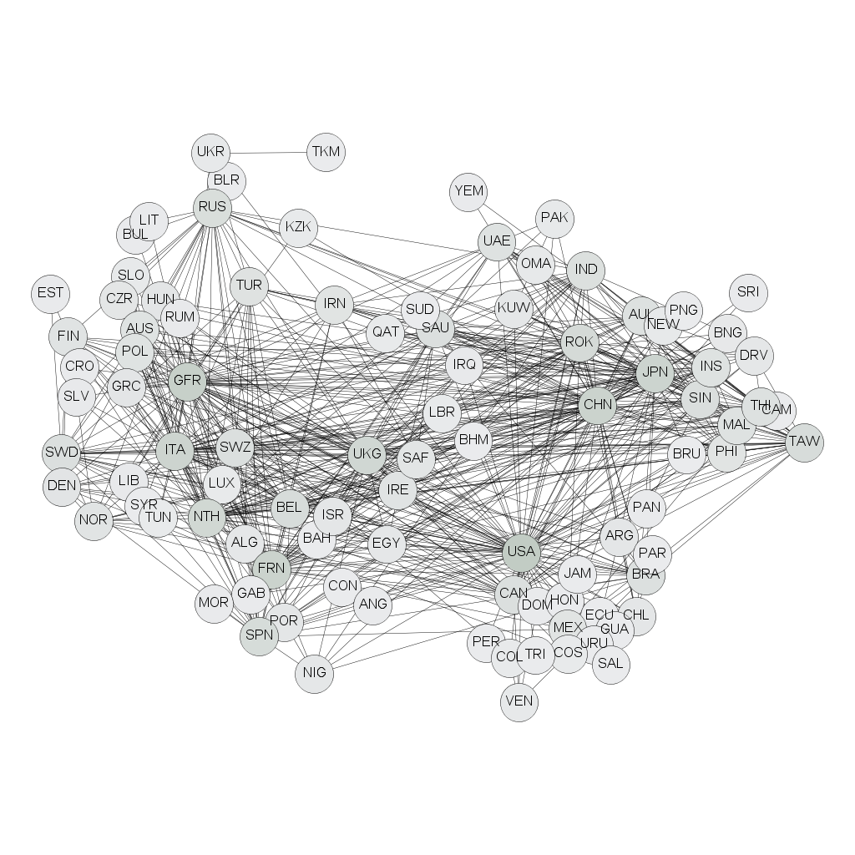
World Trade Network: 2000
Data:
Barbieri, K., Keshk, O., Pollins, B., 2008. Correlates of war project trade data set codebook, version 2.01.
Notes:
This is a representation of the WTW in the year 2000. The smallest ninety-five percent of the edges have been removed in order to make the image somewhat palatable – with all the edges the network looks like what we technically call a “hairball.”
While we can see some structure – see, for example, the central roles of China, the United States, and Germany – community structure is far from clear.

Slide 48
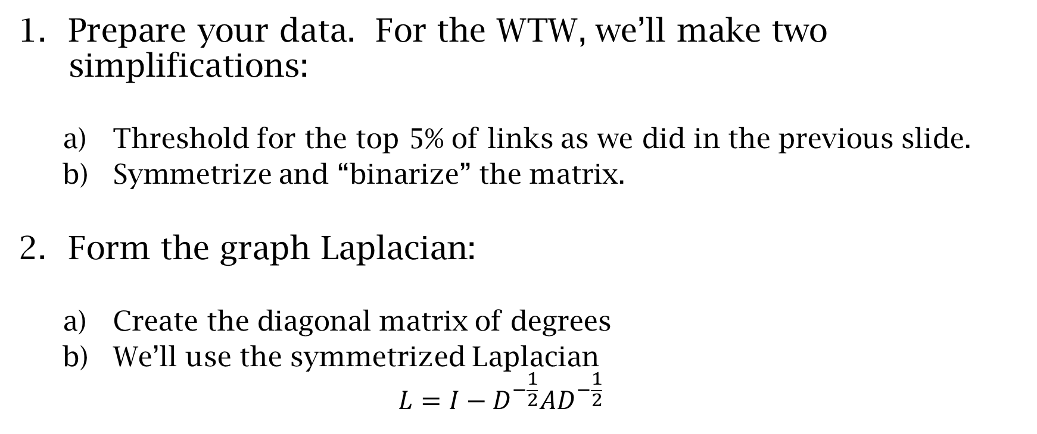
Spectral Clustering in R
Prepare your data. For the WTW, we’ll make two simplifications:
Threshold for the top 5% of links as we did in the previous slide.
Symmetrize and “binarize” the matrix.
Form the graph Laplacian:
Create the diagonal matrix of degrees
We’ll use the symmetrized Laplacian $L=I−D^{−\frac{1}{2}}AD^{−\frac{1}{2}}$
Notes:
%Read in the binary symmetric trade network data
T<-read.table("WTW2000b.csv", header = FALSE, sep = ",")
%Convert the table to a matrix
T<-as.matrix(T)
%Preallocate the diagonal matrix
D<-matrix(rep(0,96^2),nrow=96,ncol=96)
%Populate the diagonal elements
for (i in 1:96){
D[i,i]=1/sqrt(sum(T[i,]))
}
%Compute the Laplacian
L=diag(96)-D%*%T%*%D

Slide 49
R code
#Read in the binary symmetric trade network data
T<-read.table("WTW2000b.csv", header = FALSE, sep = ",")
#Convert the table to a matrix
T<-as.matrix(T)
#Preallocate the diagonal matrix
D<-matrix(rep(0,96^2),nrow=96,ncol=96)
#Populate the diagonal elements
for (i in 1:96){
D[i,i]=1/sqrt(sum(T[i,]))
}
#Compute the Laplacian
L=diag(96)-D%*%T%*%D

Slide 50
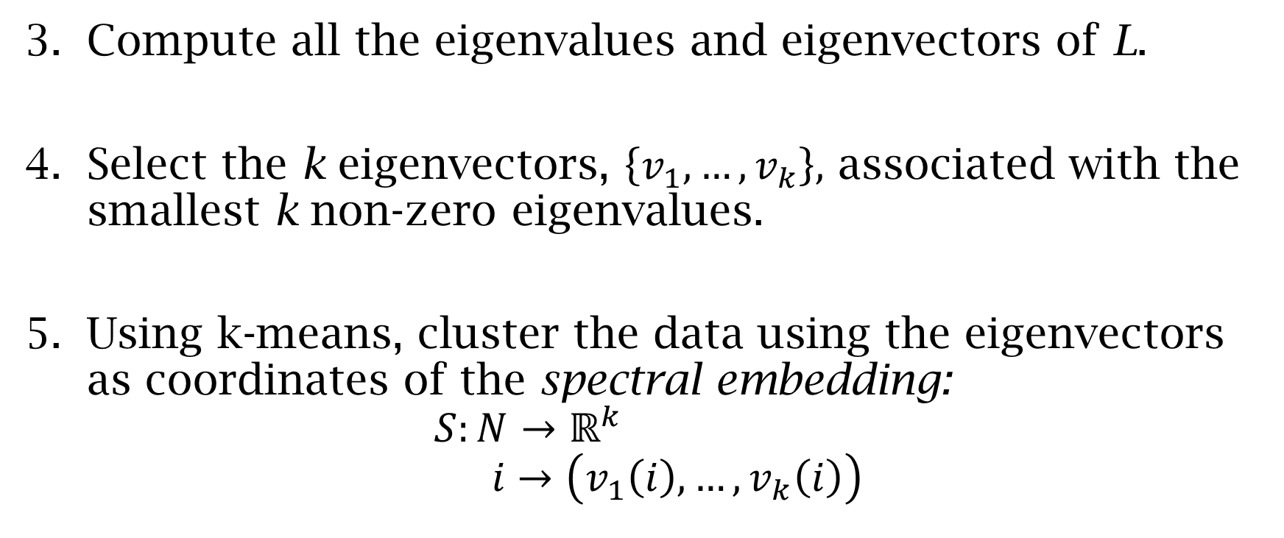
Spectral Clustering in R
Compute all the eigenvalues and eigenvectors of L.
Select the k eigenvectors, $\left\{v_{1},…,v_{k}\right\},$ associated with the smallest k non-zero eigenvalues.
Using k-means, cluster the data using the eigenvectors as coordinates of the spectral embedding:
$$S:N→ℝ^{k} \\ i→\left(v_{1}\left(i\right), …,v_{k}\left(i\right)\right)$$
Notes:
#Compute the eigendata for the matrix L
EV<-eigen(L, TRUE , only.values = FALSE, EISPACK = FALSE)
#Pull out the eigenvectors
V<-EV$vectors
#To find, for example, five clusters, we use k-means on the eigenvectors associates to the smallest 5 nonzero eigenvalues.
#As with all applications of k-means, the nstart pararmeter is particularly important – it should be made as high as is feasible.
#This will help ensure that the solution we find is close to optimal.
km<-kmeans(V[,91:95],5,iter.max=1000,nstart=5000)

Slide 51
R code
#Compute the eigendata for the matrix L
EV<-eigen(L, TRUE , only.values = FALSE, EISPACK = FALSE)
#Pull out the eigenvectors
V<-EV$vectors
#To find, for example, five clusters, we use k-means on the eigenvectors associates to the smallest 5 nonzero eigenvalues.
#As with all applications of k-means, the nstart pararmeter is particularly important – it should be made as high as is feasible.
#This will help ensure that the solution we find is close to optimal.
km<-kmeans(V[,91:95],5,iter.max=1000,nstart=5000)

Slide 52
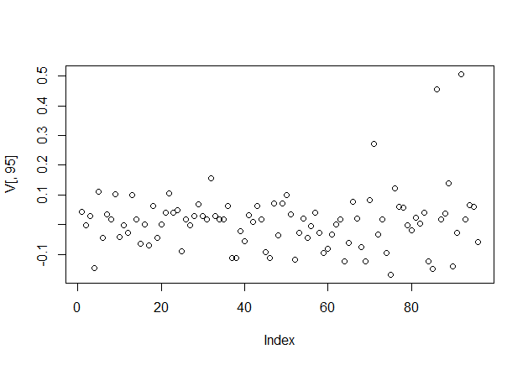
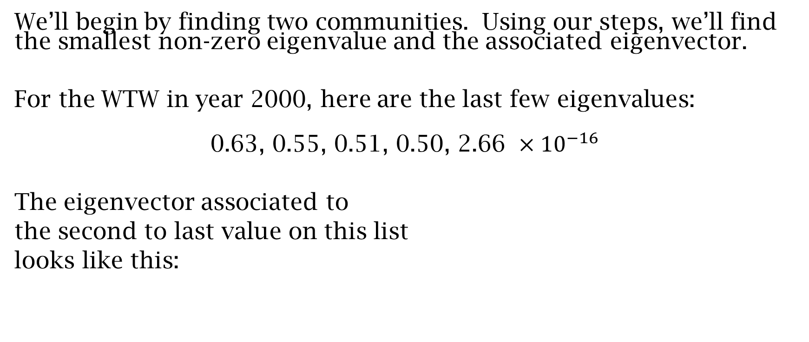
Spectral Clustering for the trade network
We’ll begin by finding two communities. Using our steps, we’ll find the smallest non-zero eigenvalue and the associated eigenvector.
For the WTW in year 2000, here are the last few eigenvalues:
$$\text{0.63, }\text{0.55, 0.51, 0.50, 2.66} ×{10}^{−16}$$
The eigenvector associated to
the second to last value on this list
looks like this:
Notes:
For two clusters, we usually simply convert the eigenvector to a vector of $±1$s by taking the sign of each entry. The two communities are then the group with positive signs and the other with negative signs.

Slide 53
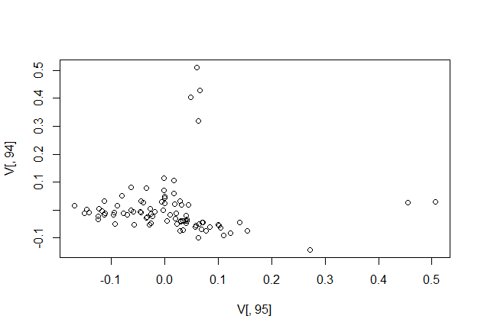
Notes:
The top image is a larger version of the image on the previous slide. The bottom image is a plot of the first and second eigenvectors, showing how we’d begin to look for larger numbers of communities. Notice, for example the points to the far right and the other group at the top.

Slide 54
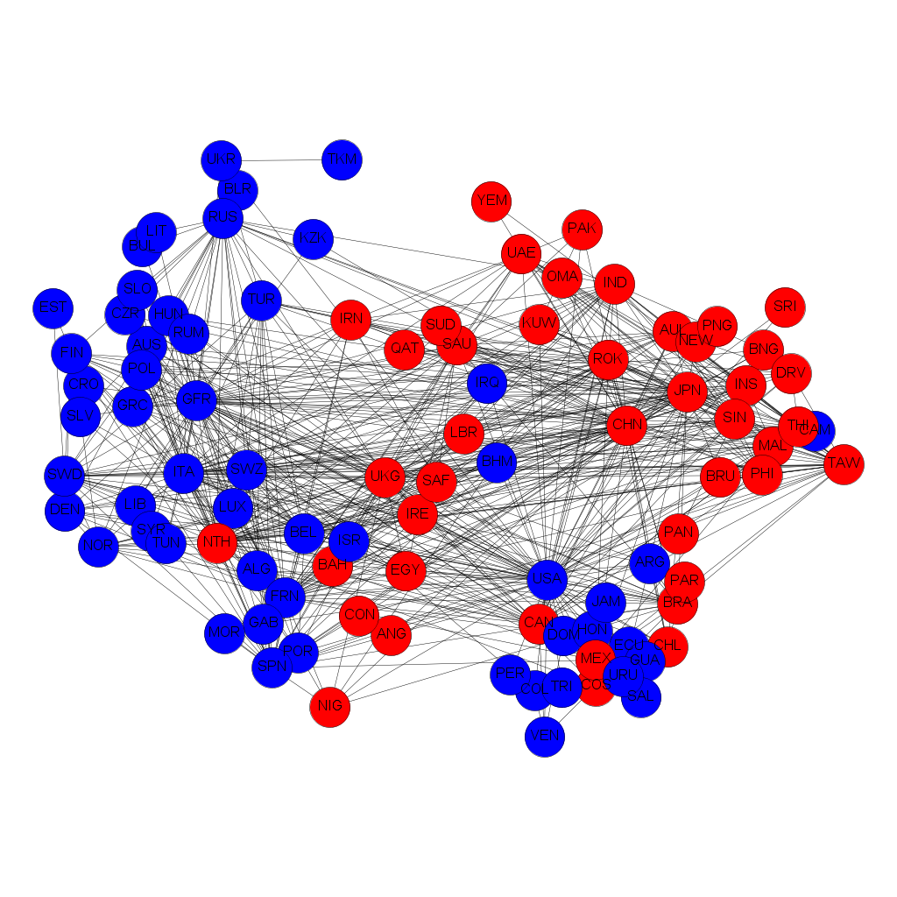
Two communities in the WTW
Notes:
This division cuts about thirty five percent of the edges.

Slide 55
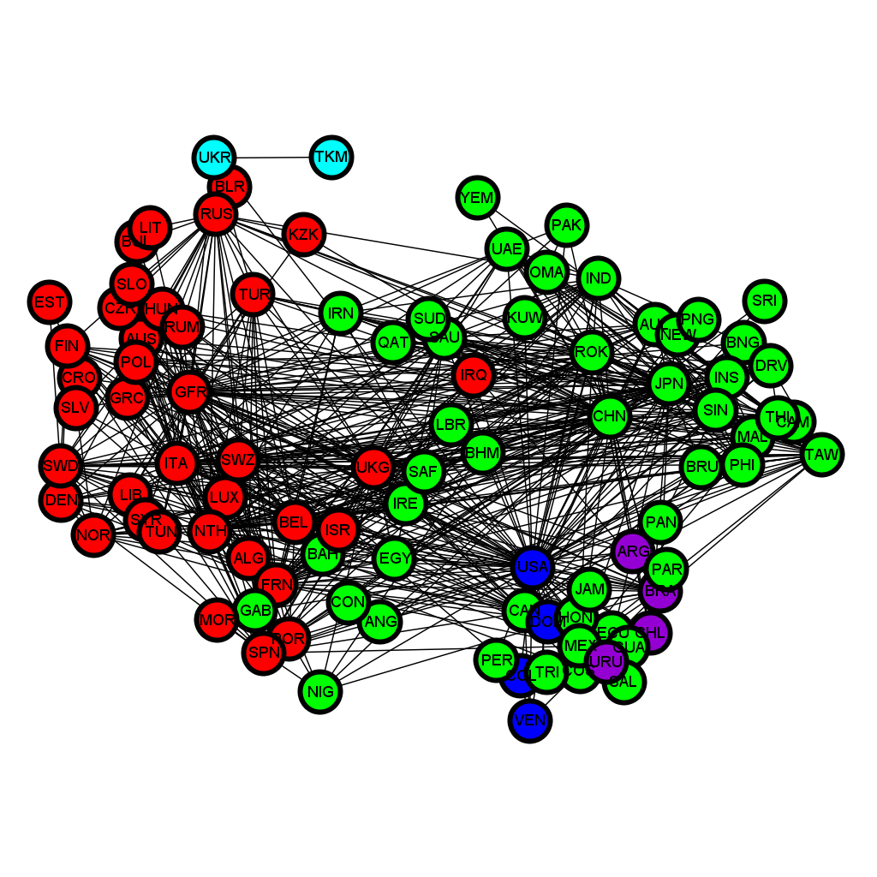
Five communities in the WTW
Notes:
This cuts about 43% of the edges.
Question: Is this too much? Is this acceptable for the definition of a community.

Slide 56
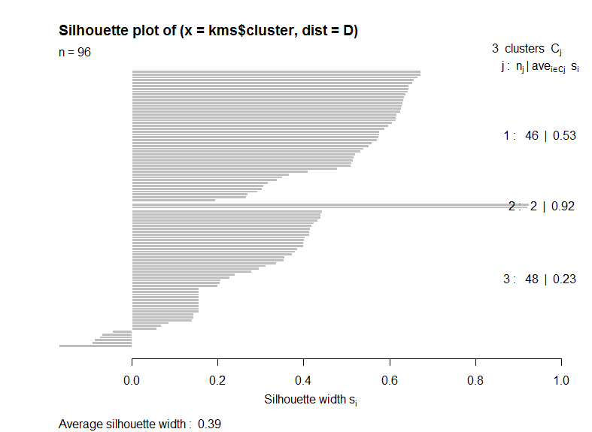
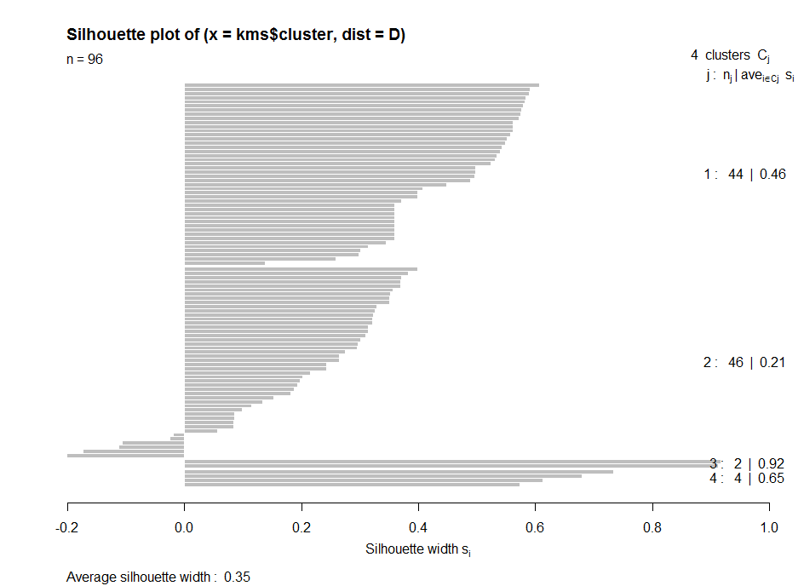
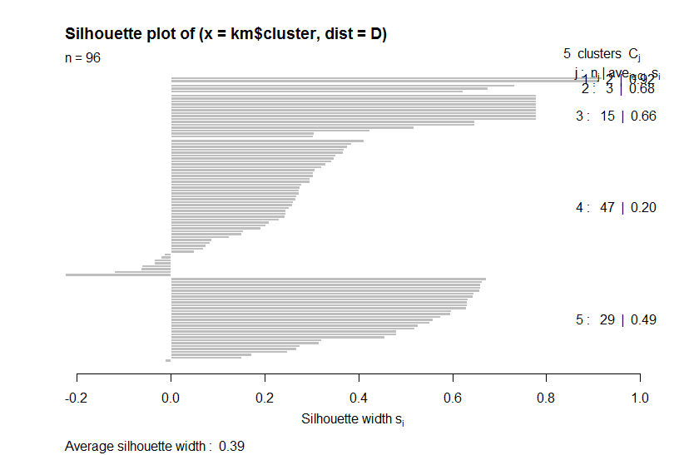
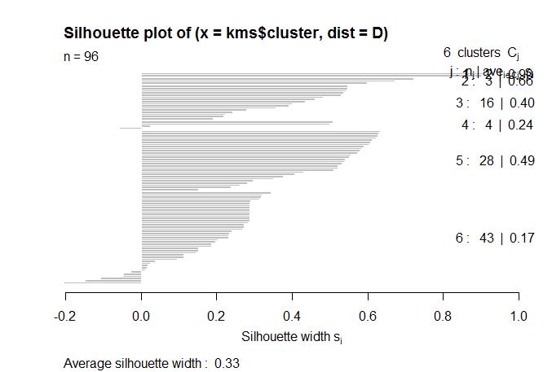
Silhouettes
#R code, look at k=3..6
for (i in 3:6){
kms<-kmeans(V[,(95-(i-1)):95],i,iter.max=1000,nstart=5000)
D=dist(V[,(95-(i-1)):95],method="euclidean")
sil<-silhouette(kms$cluster,D)
plot(sil)
}
Notes:
In thinking about how many clusters are appropriate for this data, we’ll again use the silhouette measure to see how tightly the communities are clustered. Looking at the plots shows that none of these clusterings are perfect – each has at least one cluster with potentially misclassified nodes. The choice then, is somewhat subjective.
#R code, look at 3,4,5, and 6 clusters
for (i in 3:6){
kms<-kmeans(V[,(95-(i-1)):95],i,iter.max=1000,nstart=5000)
D=dist(V[,(95-(i-1)):95],method="euclidean")
sil<-silhouette(kms$cluster,D)
plot(sil)
}

Slide 57
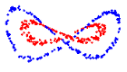
Spectral Clustering: observations and considerations
Spectral clustering finds different communities than linkage or k-means – the spectral clustering algorithm rests on a different underlying optimization.
In particular, spectral clustering can find both ball-like and non-ball-like clusters.
In the end, our algorithm only solves a relaxed version of the problem, so the solution may not be optimal.
As presented, spectral clustering requires an undirected network.
The most computationally expensive part of the algorithm is finding the eigendata.

Slide 58
Densely connected sub-networks
Another network-theoretic method for finding communities is to search for partitions of the network which have denser interconnection than you would expect.
The way to formalize this is to define the modularity of the subset and then maximize over all possible partitions.

Slide 59
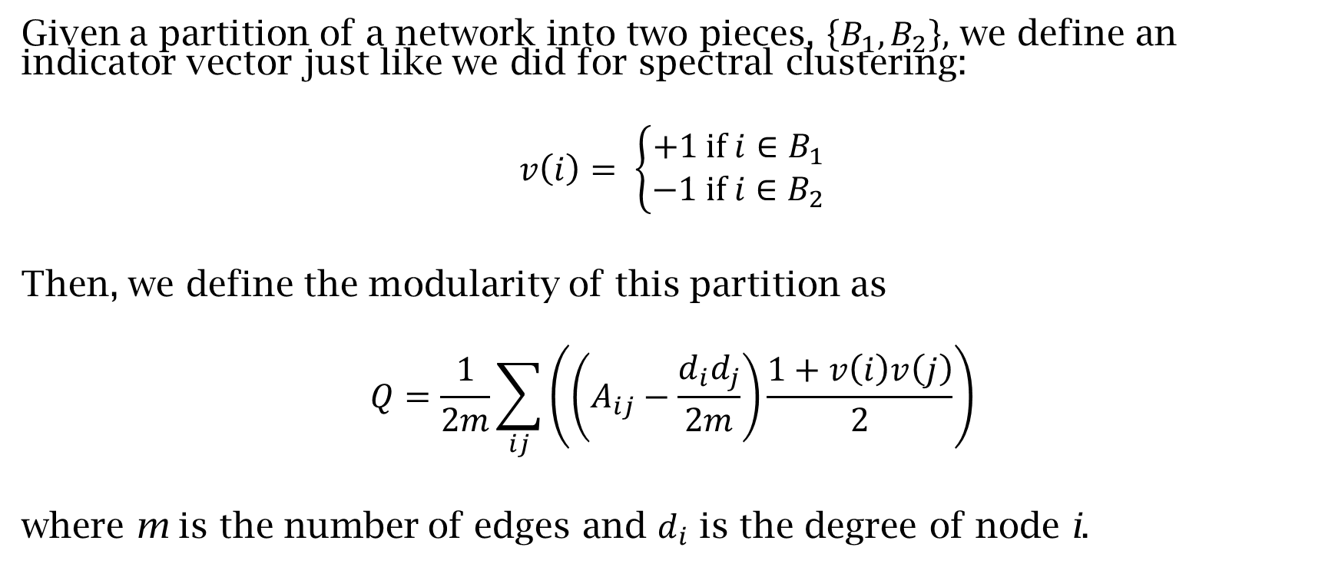
Modularity
Given a partition of a network into two pieces, $\left\{B_{1},B_{2}\right\},$ we define an indicator vector just like we did for spectral clustering:
$$v\left(i\right)= \left\{\begin{aligned}+1 \text{if} i∈B_{1} \\ −1 \text{if} i∈B_{2}\end{aligned}\right.$$
Then, we define the modularity of this partition as
$$Q=\frac{1}{2m}\sum_{ij}{\left(\left(A_{ij}−\frac{d_{i}d_{j}}{2m}\right)\frac{1+v\left(i\right)v\left(j\right)}{2}\right)}$$
where m is the number of edges and $d_{i}$ is the degree of node i.
Notes:
Initially, this looks cryptic, but let’s break it apart:
$\frac{1}{2}\sum_{ij}{A_{ij}(1+v\left(i\right)v\left(j\right)}$counts the number of edges within the two proposed communities.
$\frac{d_{i}d_{j}}{2m}$ is the expected number of edges between node i and j if we rewire the network at random.
Consequently, $\frac{1}{2}\sum_{ij}{\frac{d_{i}d_{j}}{2m}(1+v\left(i\right)v\left(j\right)}$measures the number of edges within the proposed communities that we expect. Thus, Q measures the extent to which the proposed communities have more edges than we’d expect. To find the best communities, from this point of view, we want to maximize the modularity.

Slide 60
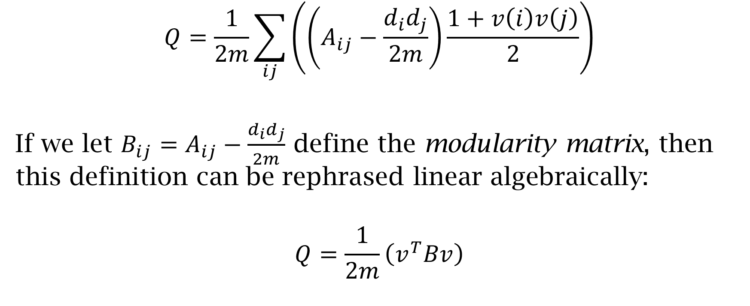
Modularity
$$Q=\frac{1}{2m}\sum_{ij}{\left(\left(A_{ij}−\frac{d_{i}d_{j}}{2m}\right)\frac{1+v\left(i\right)v\left(j\right)}{2}\right)}$$
If we let $B_{ij}=A_{ij}−\frac{d_{i}d_{j}}{2m}$ define the modularity matrix, then this definition can be rephrased linear algebraically:
$$Q=\frac{1}{2m}\left(v^{T}Bv\right)$$

Slide 61
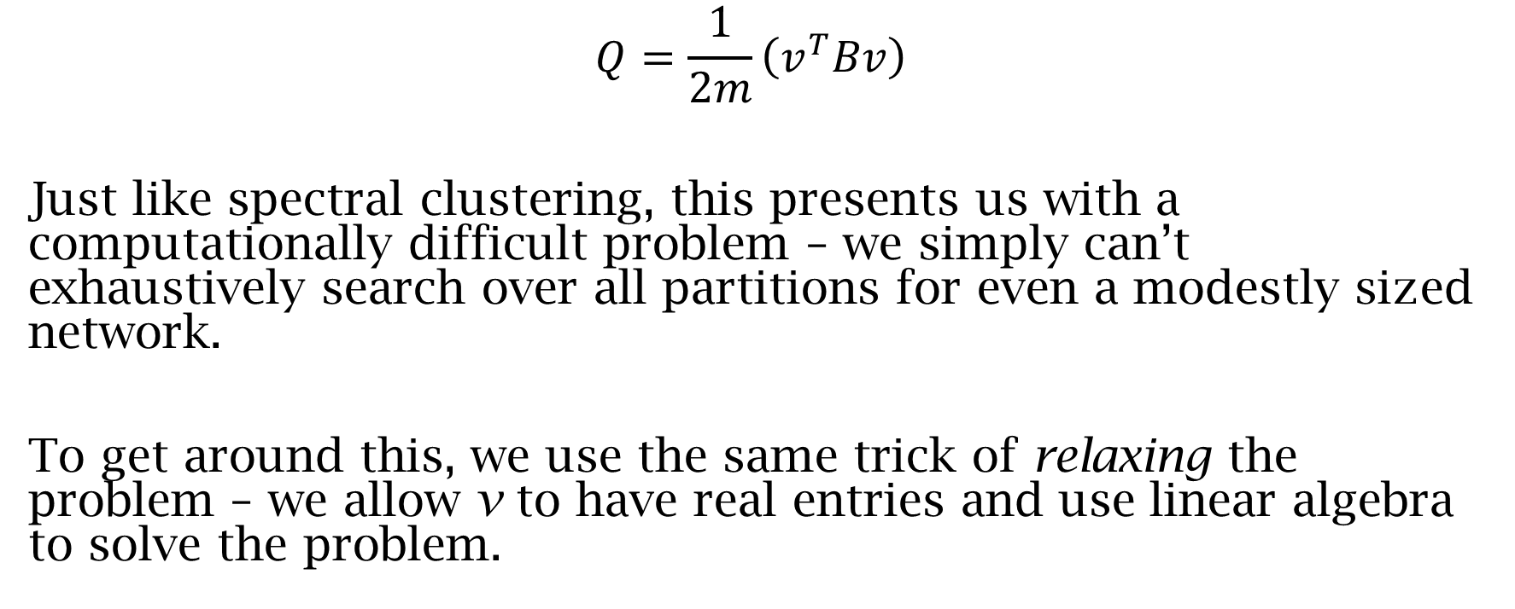
Modularity Maximization
$$Q=\frac{1}{2m}\left(v^{T}Bv\right)$$
Just like spectral clustering, this presents us with a computationally difficult problem – we simply can’t exhaustively search over all partitions for even a modestly sized network.
To get around this, we use the same trick of relaxing the problem – we allow v to have real entries and use linear algebra to solve the problem.

Slide 62
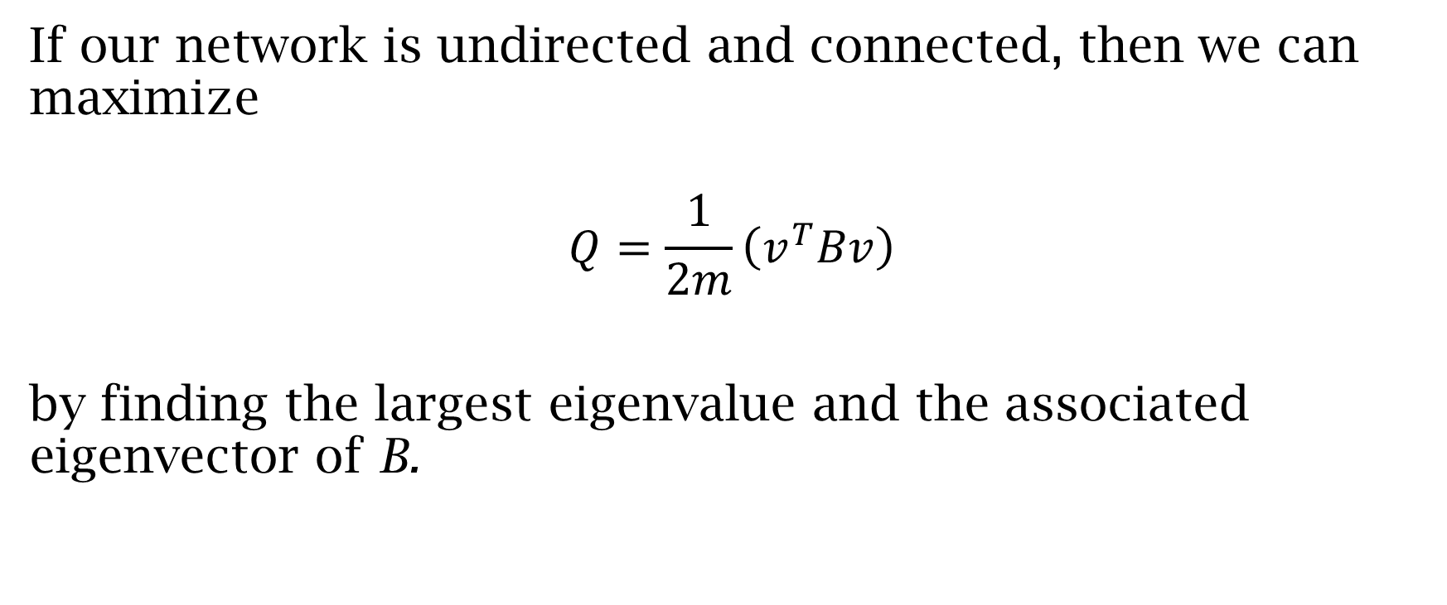
Modularity maximization
If our network is undirected and connected, then we can maximize
$$Q=\frac{1}{2m}\left(v^{T}Bv\right)$$
by finding the largest eigenvalue and the associated eigenvector of B.
Notes:
There is a lot of mathematical commonalities in our discussions of modularity and spectral clustering – this isn’t a coincidence. This type of optimization (and the relaxation of the NP-hard search problem) comes up in a lot of situations. The goal in all of these investigations is to find a form like the one in the last line - $v^{T}Bv.$ If B is symmetric then the solution is always given in terms of one of the eigenvalue/eigenvector pairs for the matrix.

Slide 63
Modularity maximization in R
Prepare your data. For the WTW, we’ll make two simplifications:
Threshold for the top 5% of links as we did in the previous slide.
Symmetrize and “binarize” the matrix.
Form the modularity matrix
Find m the number of edges
Calculate the degrees of all the nodes
Put this together to form B
Notes:
#Read in the trade data from the csv file
T<-read.table("WTW2000b.csv", header = FALSE, sep = ",")
T<-as.matrix(T)
#Calculate a vector of degrees of the trade matrix
degs<-matrix(,nrow=96,ncol=1)
for (i in 1:96){
degs[i]=sum(T[i,])
}
#Preallocate the modularity matrix
B<-matrix(,nrow=96,ncol=96)
#Calculate the number of edges
m<-nnzero(T)/2
#Populate the modularity matrix
for (i in 1:96){
for (j in 1:96){
B[i,j]=T[i,j]-degs[i]*degs[j]/(2*m)
}
}
#Find the eigendata for B
EV<-eigen(B, TRUE , only.values = FALSE, EISPACK = FALSE)
V<-EV$vectors
elst<-EV$values

Slide 64
R code
#Read in the trade data from the csv file
T<-read.table("WTW2000b.csv", header = FALSE, sep = ",")
T<-as.matrix(T)
#Calculate a vector of degrees of the trade matrix
degs<-matrix(,nrow=96,ncol=1)
for (i in 1:96){
degs[i]=sum(T[i,])
}
#Preallocate the modularity matrix
B<-matrix(,nrow=96,ncol=96)
#Calculate the number of edges
m<-nnzero(T)/2
#Populate the modularity matrix
for (i in 1:96){
for (j in 1:96){
B[i,j]=T[i,j]-degs[i]*degs[j]/(2*m)
}
}
#Find the eigendata for B
EV<-eigen(B, TRUE , only.values = FALSE, EISPACK = FALSE)
V<-EV$vectors
elst<-EV$values

Slide 65
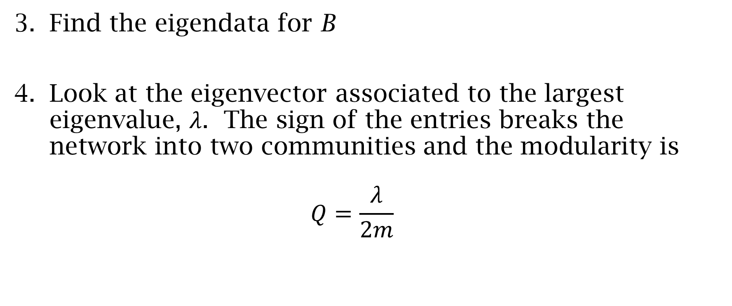
Modularity maximization in R
Find the eigendata for B
Look at the eigenvector associated to the largest eigenvalue, $λ$. The sign of the entries breaks the network into two communities and the modularity is $Q=\frac{λ}{2m}$
Notes:
#Find the eigendata for B
EV<-eigen(B, TRUE , only.values = FALSE, EISPACK = FALSE)
V<-EV$vectors
elst<-EV$values

Slide 66
R code
#Find the eigendata for B
EV<-eigen(B, TRUE , only.values = FALSE, EISPACK = FALSE)
V<-EV$vectors
elst<-EV$values

Slide 67
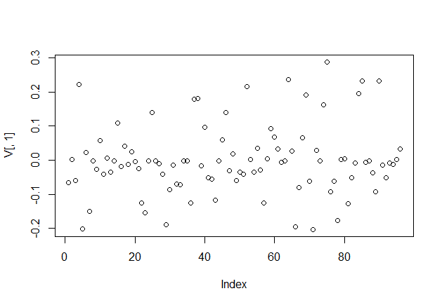
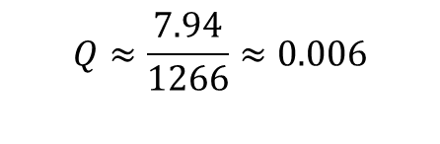
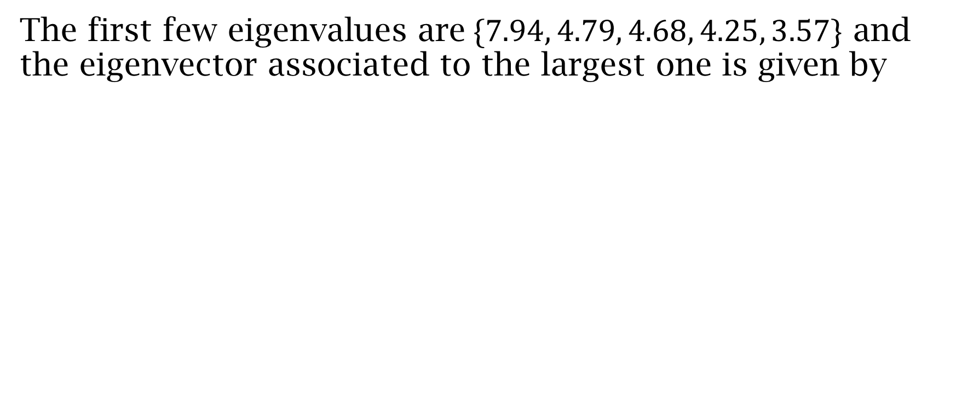
Modularity maximization in the WTW
The first few eigenvalues are$\{7.94, 4.79, 4.68, 4.25, 3.57\}$ and the eigenvector associated to the largest one is given by
$$Q≈\frac{7.94}{1266}≈0.006$$
Notes:
The modularity in this case is small – quite close to zero. Generally, to conclude there are reasonable communities, we’d like to see a larger Q. One cutoff used in some of the literature is $Q>0.4$. This set of communities would fail that test and we’d conclude that there are no “significant” communities.
On the other hand, the statistical framework in modularity maximization indicates this is a breakup into communities which are denser than we expect – just not very much so. If all the eigenvalues of B were non-positive, we’d be left with 0 as the maximum eigenvalue and the associated vector of 1s as the eigenvector. In that case, the algorithm indicates that there are no communities.

Slide 68
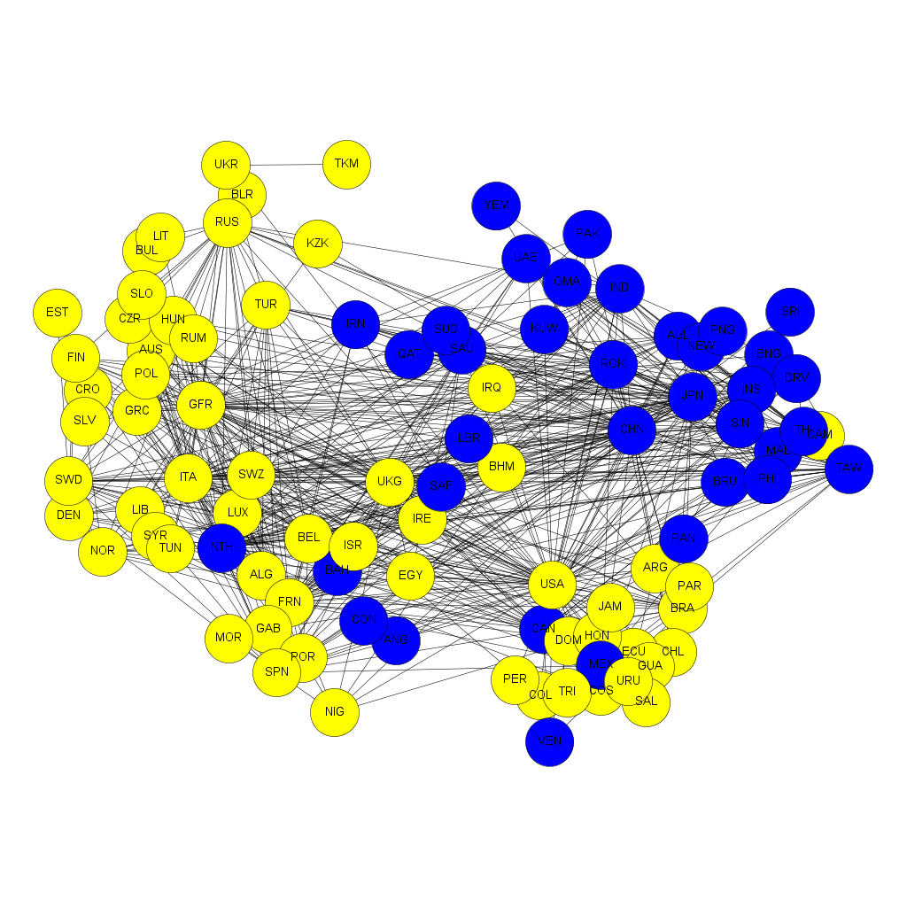
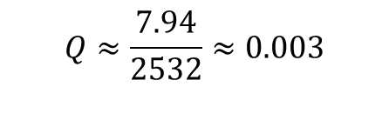
Densely connected communities in the WTW
$$Q≈\frac{7.94}{2532}≈0.003$$

Slide 69
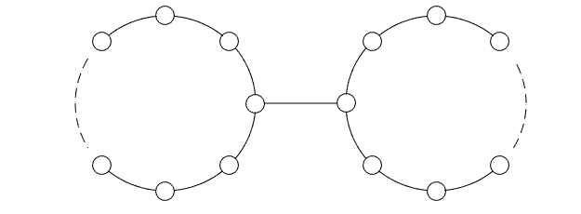
Modularity vs. Spectral Clustering
Breaking the WTW into two using spectral clustering and modularity maximization yield almost the same set of communities.
This is not always the case – the two algorithms are optimizing different functions. The example to the right illustrates part of this issue.

Slide 70
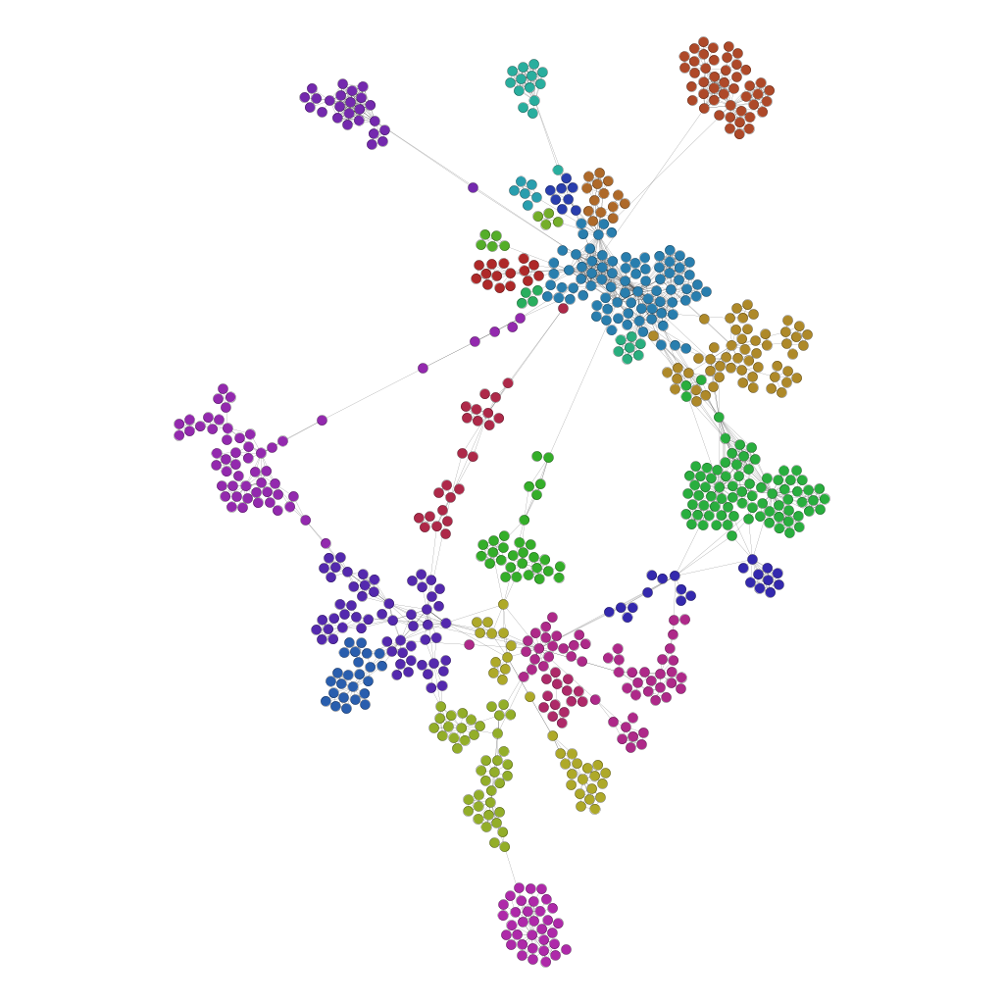
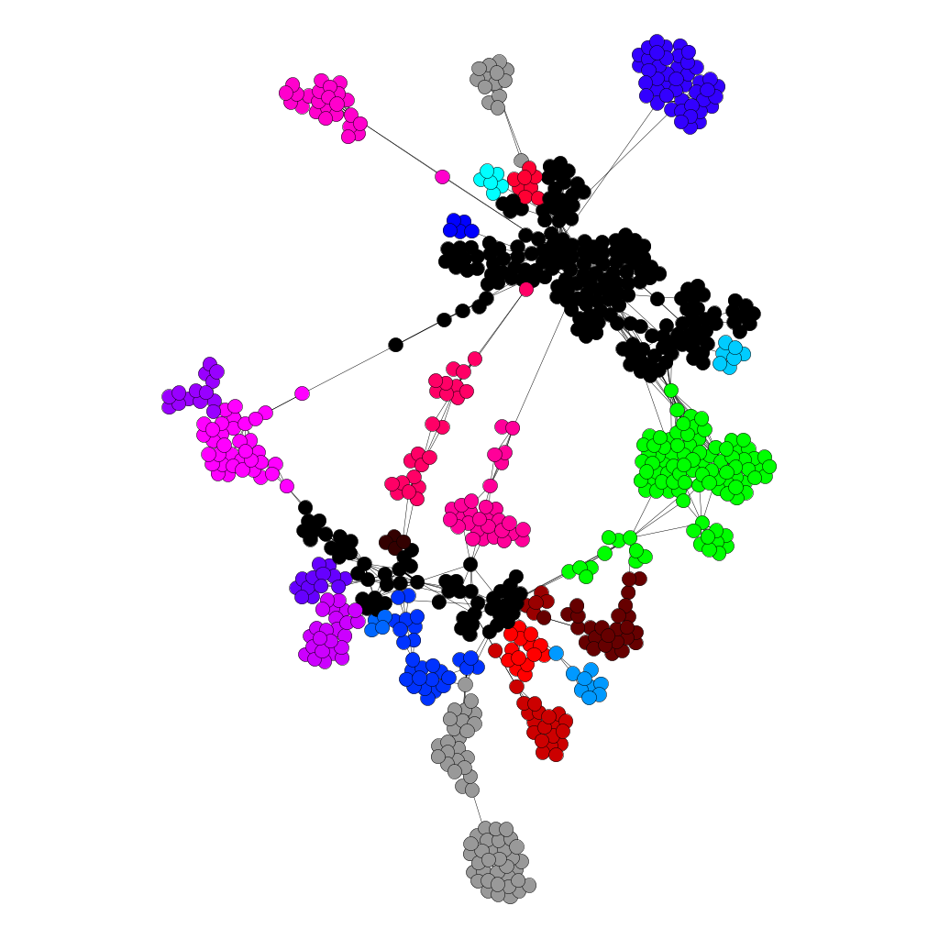
Crime incident network: a comparison
Notes:
Spectral clustering (left) with 25 clusters and modularity maximization (right) with 25 clusters as well.

Slide 71
Finding more than two communities
For spectral clustering, we had a heuristic method for finding more than two communities which relies on another clustering method – k-means.
One of the nice theoretical aspects of modularity maximization is that we can use more firmly grounded methods to find k communities.

Slide 72
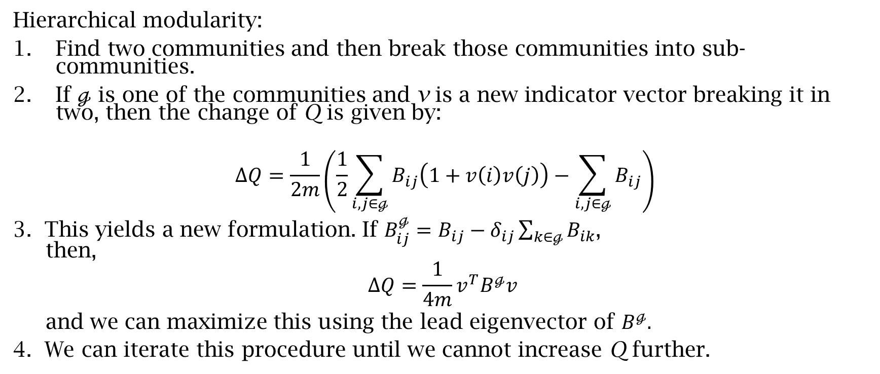
Finding more than two communities
Hierarchical modularity:
Find two communities and then break those communities into sub-communities.
If $ℊ$ is one of the communities and v is a new indicator vector breaking it in two, then the change of Q is given by:
$$ΔQ=\frac{1}{2m}\left(\frac{1}{2}\sum_{i,j∈ℊ}{B_{ij}\left(1+v\left(i\right)v\left(j\right)\right)}−\sum_{i,j∈ℊ}{B_{ij}}\right)$$
3. This yields a new formulation. If $B_{ij}^{ℊ}=B_{ij}−δ_{ij}\sum_{k∈ℊ}{B_{ik}}$, then,
$$ΔQ=\frac{1}{4m}v^{T}B^{ℊ}v$$
and we can maximize this using the lead eigenvector of $B^{ℊ}.$
4. We can iterate this procedure until we cannot increase Q further.
Notes:
DETAILS ON FORMULA-DISCUSS ITS PIECES

Slide 73
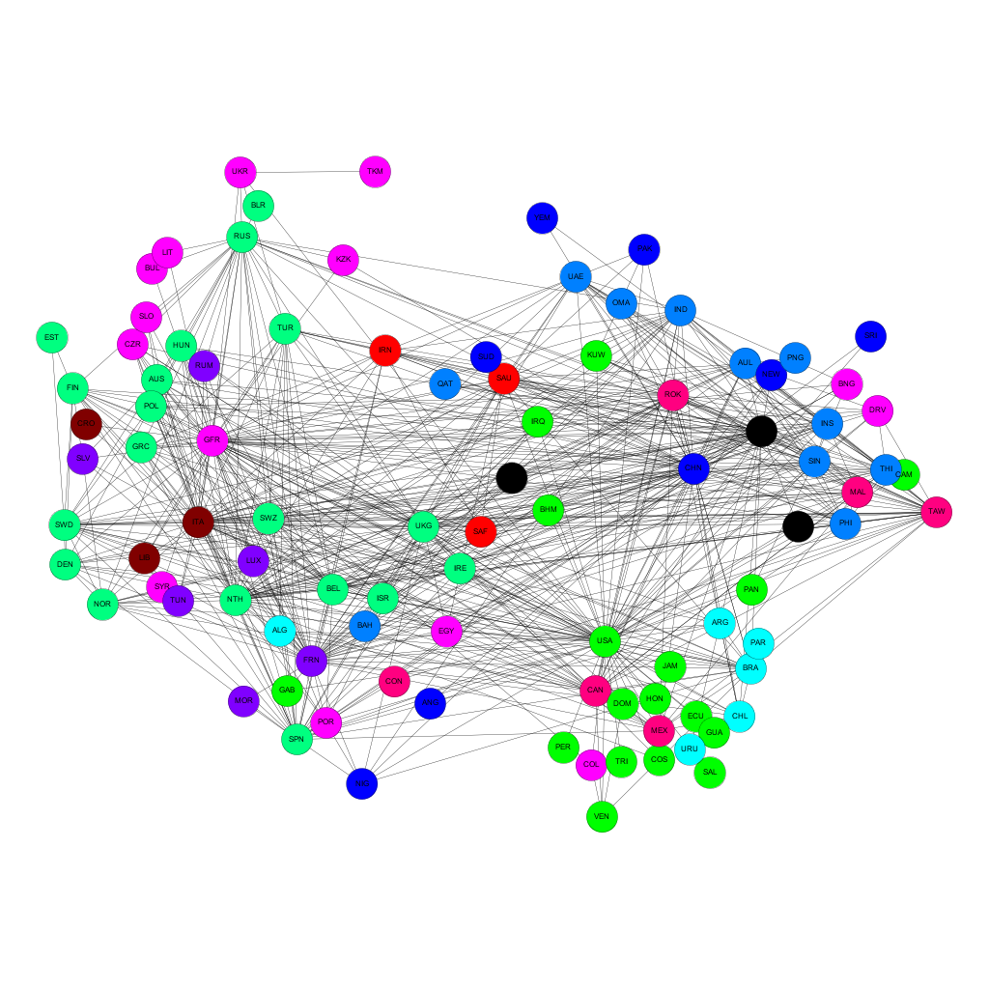
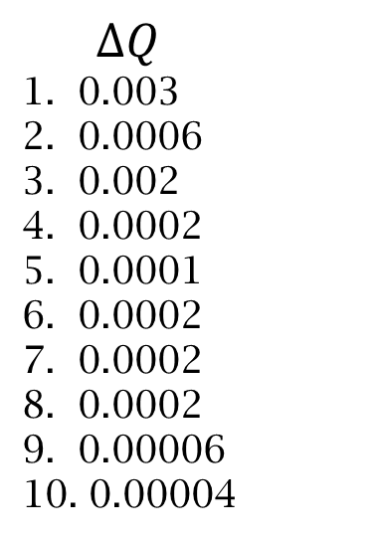
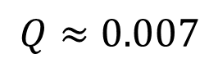
Communities in the WTW
$$ΔQ$$
0.003
0.0006
0.002
0.0002
0.0001
0.0002
0.0002
0.0002
0.00006
0.00004
$$Q≈0.007$$
Notes:
The file trade_mod_eg_2.R contains code that automates this process.
Our algorithm proceeds for 10 iterations before it can no longer find at least one community which can be split for an increase in modularity. From the list of $ΔQ$, we see that some splits give larger gains than others but most are still quite small. The overall Q for this subdivision into 11 communities is 0.007 a gain of roughly 0.004 from the original two communities division.
Once again, there is a decision to be made on interpretation – while these communities have mathematical meaning, are they significant with regard to the applications we might be thinking of?

Slide 74
Communities in the WTW
Notes:
Compare spectral clustering to modularity – the spectral clustering results have fewer clusters (and two that dominate in membership).
Questions:
Which of these, if either, is a more reasonable division of the WTW into communities?
Is counting cut ties or overall density a better choice for the WTW?

Slide 75
Modularity: observations and considerations
Modularity has a nice statistical basis – it optimizes a function based on the density of the groups compared to the expected density of a random graph model.
While modularity and spectral clustering sometimes find the same communities, modularity is optimizing a different function.
Like spectral clustering, modularity (as presented) requires an undirected network. There are, however, versions for directed (see []).
The most computational expensive part of this version of modularity maximization is the computation of the eigendata. For large networks, other algorithms exist (see []) and some are even in R (see fastgreedy.community in igraph)

Slide 76
Further directions
Use linkage or k-means with a measure of similarity more appropriate to your application.
For spectral clustering, we can iterate the 2 cluster method to find a hierarchical version of k communities. Similarly, we could use linkage on the spectral embedding for a similar purpose.
Modularity maximization for more than 2 clusters can also be achieved using non-hierarchical algorithms.
Both modularity and spectral clustering have versions for weighted directed networks.

Slide 77
Social Identity Voting
Notes:
Joint work with Greg Leibon and Dan Rockmore.
What was the goal of finding communities? Positing that social identity drives voting led us to try to detect the groups to which the legislators belonged through their votes on different bills. The hypothesis was that to build social unity (and capital) members in groups would gain utility from voting together.
We used spectral clustering on an adjacency matrix derived from correlation. Why? Correlation emphasizes shape of the voting profiles and spectral clustering emphasizes divisions between groups – we wanted to allow for loosely connected ideological communities so as to be able to detecting ones that were just forming and becoming cohesive.
At the coarsest level we found something expected – party identification. But underneath that, there were lots of issue oriented and at times bipartisan groups (see left hand figure).
As an application, we took a closer look at the Tea Party caucus and found that they had not (yet?) formed a coherent ideological unit but were instead split between several other subgroups.

Slide 78
Communities in the United Nations
Notes:
In more recent work with Skyler Cranmer, we looked at communities in the UN as witnessed by their general assembly votes.
Why find communities? Here, we wanted to understand the extent to which behavior at the UN was predictive of various aspects of international relations (conflict, alliances, the spread of democracy). We hypothesized that the meso-scale structure revealed by the community structure would be reflective of these other processes.
As with SIV, we used spectral clustering on an adjacency matrix derived from the correlation matrix of voting profiles. We chose these for similar reasons.
The image is our representation of the community structure – the red and blue circles showing the dominant sub-cluster of each of the two basic meta-clusters in the data. Other circles in their “orbit” are the other sub-clusters in the meta-cluster. We selected these two time periods to show the heterogeneity over time.

Slide 79
Final points
Only set out to find communities in your data if you have a good reason.
Identification of meso-scale structure is likely the most fruitful and novel type of results you can expect from community detection.
All clustering/community detection algorithms are grounded in a set of assumptions – choose the one that is most compatible with your application.
Interpretation of the clusters is often the most difficult and potentially most rewarding aspect of community detection.

Slide 80
Overviews and review articles
[1] M. E. J. Newman, Communities, modules and large-scale structure in networks. Nature Physics 8, 25–31 (2012) doi:10.1038/nphys2162
This is a very nice overview of the state of clustering and community detection for network data. The point of view stems from the development of these ideas within the physics community so it may not align precisely with the concerns and conventions of political science.

Slide 81
Data references
[2] K. Poole, voteview.com
Roll call voting data for US House and Senate
[3] Barbieri, K., Keshk, O., Pollins, B., 2008. Correlates of war project trade data set codebook, version 2.01.
While the COW website has a great deal of data, we
use the bilateral trade data for our example.

Slide 82
Linkage and k-means
These algorithms are so well established, it is not terribly useful to provide original references. However, there are a number of excellent books which include discussions of these techniques.
We also have a discussion of both in the notes.

Slide 83
Spectral Clustering
[4] Ng, A., Jordam, M., and Weiss, Y. (2001) On Spectral Clustering: Analysis and an algorithm. Advances in NIPS, 849-856.
This is a reasonably theoretical discussion of spectral clustering and presents it in a slightly different form than we discussed.
[5] Shi, J. and Malik, J. (2000) Normalized Cuts and Image Segmentation. IEEE Transactions on PAMI, 22(8): 888-905.
This presentation gives a nice connection between cut problems and spectral clustering. There are also nice applications to image processing.
[6] Riolo, M. and Newman, M.E.J. (2014) First-principles multiway spectral partitioning of graphs, Journal of Complex Networks 2, 121-140 (2014).
This is a nice ground up geometric derivation of spectral clustering for finding communities in networks.

Slide 84
Modularity
[7] Newman, M. E. J. (2006). Modularity and community structure in networks. Proceedings of the National Academy of Sciences of the United States of America 103 (23): 8577–8696.
This is, in a sense, the first complete article on modularity maximization.
[8] Leicht, E. A., Newman, M. E. J. (2008) Community Structure in Directed Networks. Phys. Rev. Lett. 100, 118703.
This paper extends modularity maximization to directed networks.
[9] Clauset, A., Newman, M. E. J., and Moore, C. (2004). Finding community structure in very large networks. Phys. Rev. E 70 (6): 066111.
The authors tackle the computational complexity problem associated with finding eigendata for large matrices.

Slide 85
Applications
[10] Pauls, S. D., Leibon, G., and Rockmore, D. (2015) The Social Identity Voting model: ideology from community structures, Research and Politics, April-June 2015, 1-11. (doi: 10.1177/2053168015570415) Pauls, S. D., 2015, "Replication Data for: The Social Identity Voting model: ideology and community structures", http://dx.doi.org/10.7910/DVN/IMLVVG, Harvard Dataverse.
[11] Pauls, S. D. and Cranmer, S. (2015) Affinity Communities in United Nations Voting: Implications for Conflict, Cooperation, and Democracy. Preprint.

